Slide 1
MARKET & PRICE
4hrd 2018_19

Slide 2
https://www.youtube.com/watch?v=RP0j3Lnlazs&list=PL1oDmcs0xTD9Aig5cP8_R1gzq-mQHgcAH&index=12

Slide 3
DEMAND CURVE IMPORTANT TERMS
Demand = Quantity of goods and services that consumers are willing and able to purchase at various prices during a given period of time
Individual demand = Demand of just one consumer
Market demand = Total demand for a product from all its consumers
Quantity demanded = Amount of a good or service consumers consumers are willing and able to buy

Slide 4
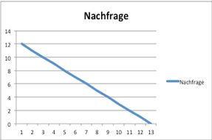
DEMAND CURVE
PRICE | DEMAND
1 | 11
2 | 10
3 | 9
4 | 8
5 | 7
6 | 6
7 | 5
8 | 4
9 | 3
10 | 2
11 | 1
Demand
Demand curve

Slide 5
SUPPLY CURVE IMPORTANT TERMS
Supply = Amount of a good and service producers or companies are willing to produce and sell at different prices
Quantity supplied = Amount of a good or service producers are willing and able to produce and sell to consumers in a market
The Market supply of a product consists of the amount supplied by all the individual producers competing to supply a the product.

Slide 6
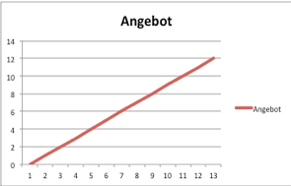
SUPPLY CURVE
PRICE | Supply
1 | 11
2 | 10
3 | 9
4 | 8
5 | 7
6 | 6
7 | 5
8 | 4
9 | 3
10 | 2
11 | 1
Supply
Supply curve

Slide 7
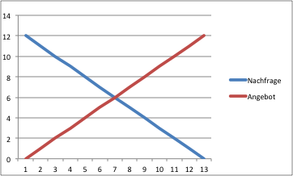
Market Equilibrium
In a graph, equilibrium is found where the demand and the supply curve cross.
Market function | Price function
Supply | signal
coordination | rationalization
pricing | selection
distribution | control
Demand curve
Supply curve

Slide 8
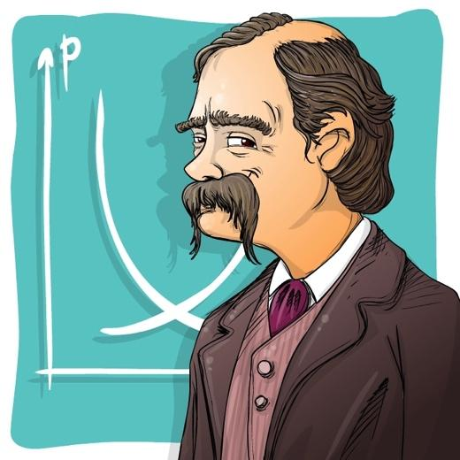
the market model
Alfred Marshall (1842-1924) founded the neoclassic theory
the neoclassic theory is, to this day, the predominant theory of economics
through further development of the classic theory, the theory of equilibrium was developed
→ micro economics = the analysis of behavior of individual subjects of the economy

Slide 9
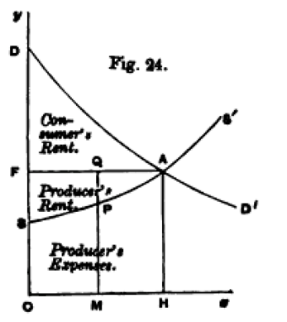
the principles of economics the market model, weaknesses
A graphical expression of
- Demand curve, supply curve, market price
-the consumer‘s rent and
- the producer‘s rent and the expenses
Model assumptions partly unrealistic:
-no „homo oeconomicus“ are humans just utility maximisers?
-no preferences of consumers
-no homogenous products
-no complete market transparency
-time is not considered as a key factor

Slide 10
Disequilibrium in the Market
Excess Supply:
If there are more supplies than demands
→ leads to excess Supply
= possible price reduction
Excess Demand:
If there are more demands than supplies
→ leads to excess demand
= possible price increase
Demand curve
Supply curve

Slide 11
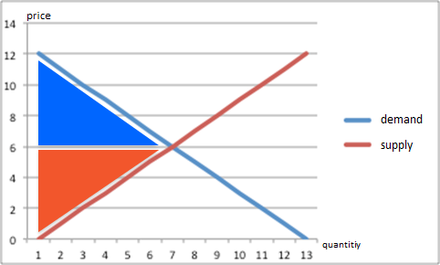
consumer and producer rent

Slide 12
consumer rent
consumers can buy at the equilibrium price, those who would be willing to pay a higher price will obtain a rent
the consumer rent holds an overall advantage for consumers who were willing to pay a higher price than the market price

Slide 13
producer rent
producers, who would be willing to sell at a lower price than the equilibrium price obtain a rent
the producer rent is the overall advantage for the providers, who were willing to sell at a lower price than the market price

Slide 14
Shifts of Curves

Slide 15
Demand Curve
Fall in demand
Fall in consumers income (rising unemployment, increase of tax)
change in in taste
Rise of substitutes price or fall of complements prices
The demand curve shifts to the left; Consequences: a price reduction
Rise in demand
Increase of income (reduction of income tax, rising employment)
Rise of price of substitutes and fall of prices of complements
Increased advertisind, other factors, hot summer,...
The demand curve shifts to the right, Consequences: increase in price
Preis
Demand curve
Supply curve
Menge

Slide 16
Supply Curve
Decrease of supply
Other products become more profitalbe
Rise of cost of employing factors (higher salary costs, machines,...)
Fall in business optimism of sellers/producers
Government withdraws subsidies
The supply curve shifts to the left, Consequences: increase in price
Rise in supply
Other products become less profitable,
Good harvest, Government pays subsidies,...
Technical progress, improvement of production (mobile phones,...)
Increas of business optimism
The supply curve shifts to the right, Consequences: reduction of the price
Preis
Demand curve
Supply curve
Menge

Slide 17
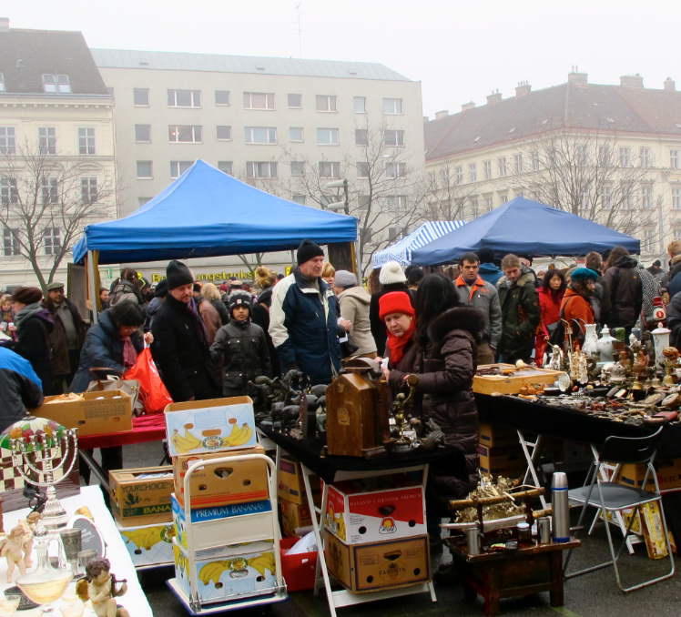
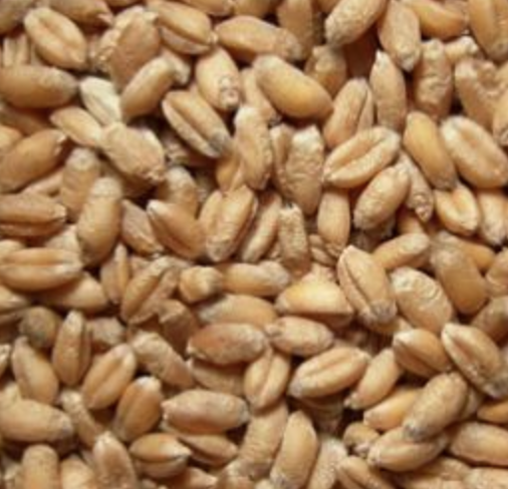
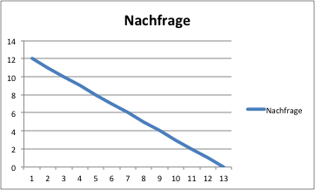
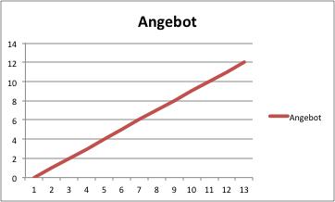
Market and
Price
Goals/Competences: market equilibrium, explain the consumer and producer rent, be able to interpret shifts of demand and supply curves
1) Demand Curve
2) Supply Curve
3) Market Equilibrium
4) Market Modell
Demand Curve
= displays how the demanded quantity depends on the price
The higher the price the lower the demand.
Supply Curve
= displays how the supplied quantity depends on the price
The higher the price the higher the supply
Market Equilibrium
In a graph equilibrium is found where the demand and supply curves cross
Alfred Marshall
(1842-1924)
Founder of Neoclassic – until this day it‘s a prevailing theory of economics
Further development of the classical theory
Equilibrium theory
Microeconomics – analysis of behaviour of individual economic entities
„Principles of Economics“:
Model assumptions partly unrealisitic:
homo oeconomicus (utility maximization)
no price agreements
no preferences
homogen products
complete market transparency
time is not a factor
Price | demand
1 | 11
2 | 10
3 | 9
4 | 8
5 | 7
6 | 6
7 | 5
8 | 4
9 | 3
10 | 2
11 | 1
Price€ | supply
1 | 1
2 | 2
3 | 3
4 | 4
5 | 5
6 | 6
7 | 7
8 | 8
9 | 9
10 | 10
11 | 11
Price
Price
Demand
Price
Supply
Quantity
market function
supply
coordination
pricing
distribution
price function
signal
rationalization
selection
control
Quantity
Quantity
5) Disequilibirum in the Market
6) Consumer- and Producer Rent
Consumer Rent
All consumers can buy at the equilibrium price, but those who would be willing to pay a higher price will therefor obtain a rent
The consumer rent therefore holds an overall advantage for the consumers who were willing to pay a higher price than the market price.
Price
Excess Supply
if price above equilibrium price → more supply than demand → leads to excess supply
Consequences > possible price reduction
Price
Excess Demand
If price beneath equilibrium price → more demand and supply → leads to excess demand
Consequences > possible price increase
Producer Rent
All providers, who would be willing to sell at a lower price than the equilibrium price obtain a rent.
The producer rent therefore is the overall advantage for the providers, who were willing to sell at a lower price than the market price.
Quantity
Quantity
7) Shifts of Curves: demand and supply curves
Price
Decrease of supply (< to the left)
e.g. supply decreases because of crop shortfall, other products become more profitable, rise of production cost,
Fall in business optimism, ...
< shift to the left
consequences: price increase
Price
Fall in demand (< to the left)
e.g. due to change in taste (many vegetarians), fall of disposable income (tax increase), fall of prices of substitutes, rise of prices of complements, changes in taste in favour of other products, reduction of advertising, fall in the population, ... shift of the demand curve to the left: consequences → price reduction of meat
Rise in supply (> to the right)
e.g. very good crop leads to supply growth, other products bedome less profitable, fall of production cost, increase in supply of resources, increase in optimism
> shift to the right
consequences: price reduction
Rise demand (> to the right)
e.g. public festival: beer – demand of beer increases, increase of advertising, increase of income, rise of prices of substitutes, fall of price of complements, rise in population, other facors like hot weather,...
shift of the demand curve to the right: consequences → price increase
Quantity
Quantity

