Slide 1
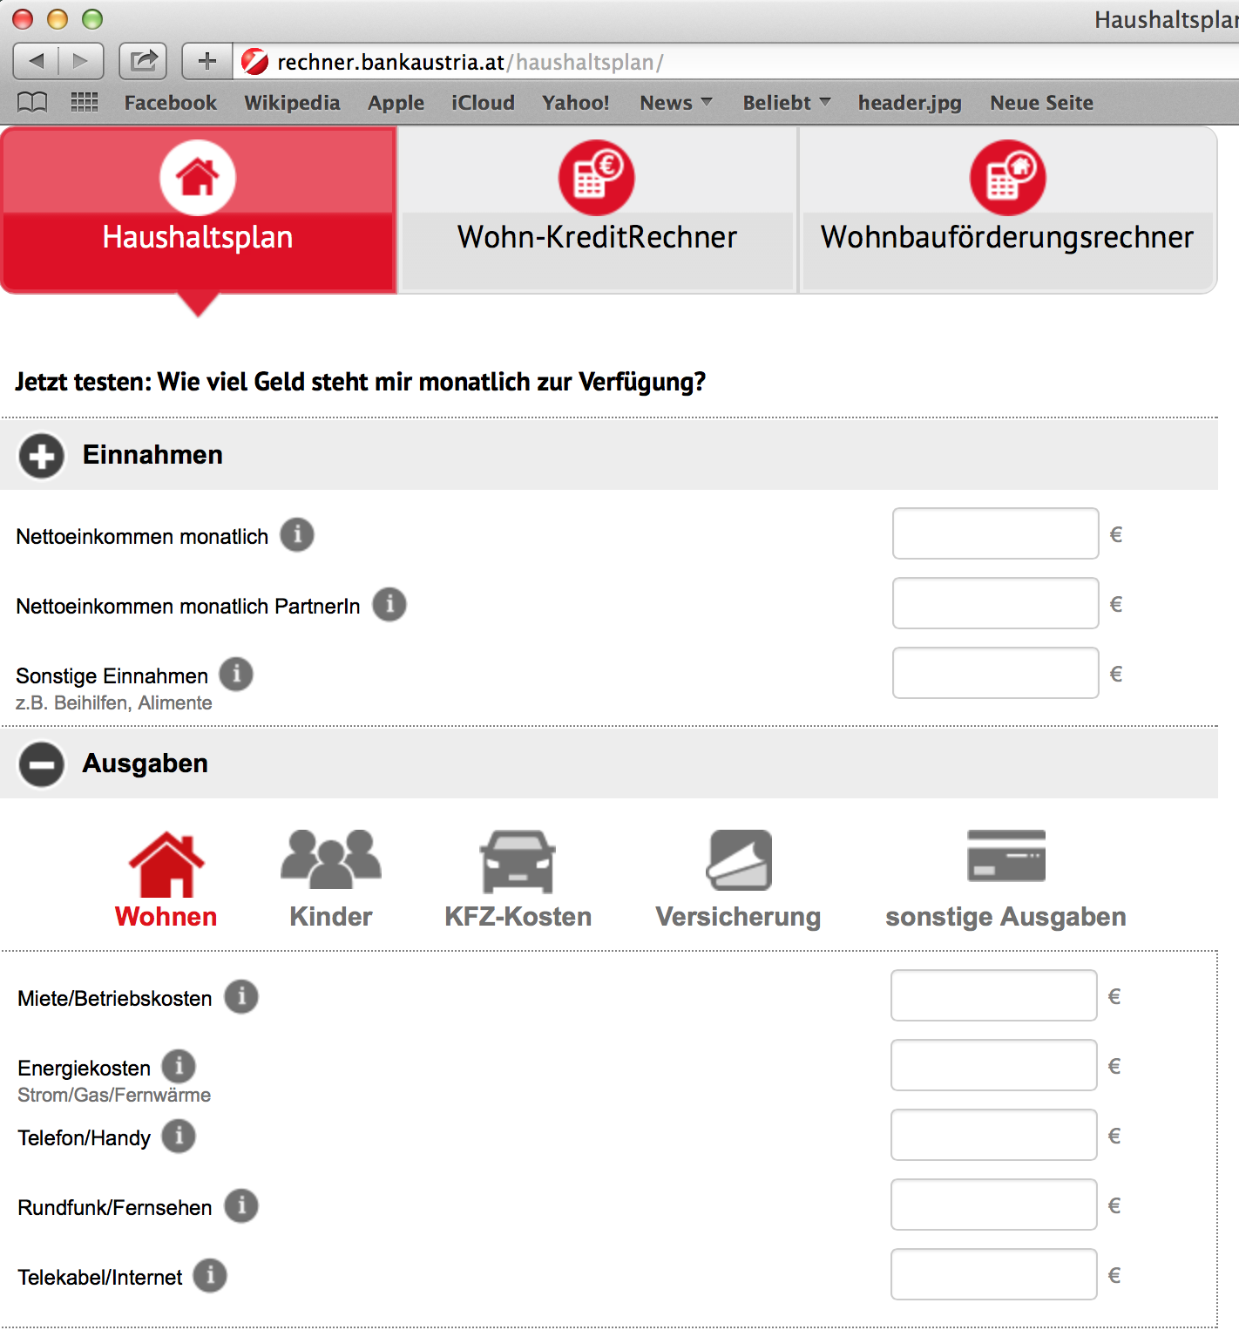
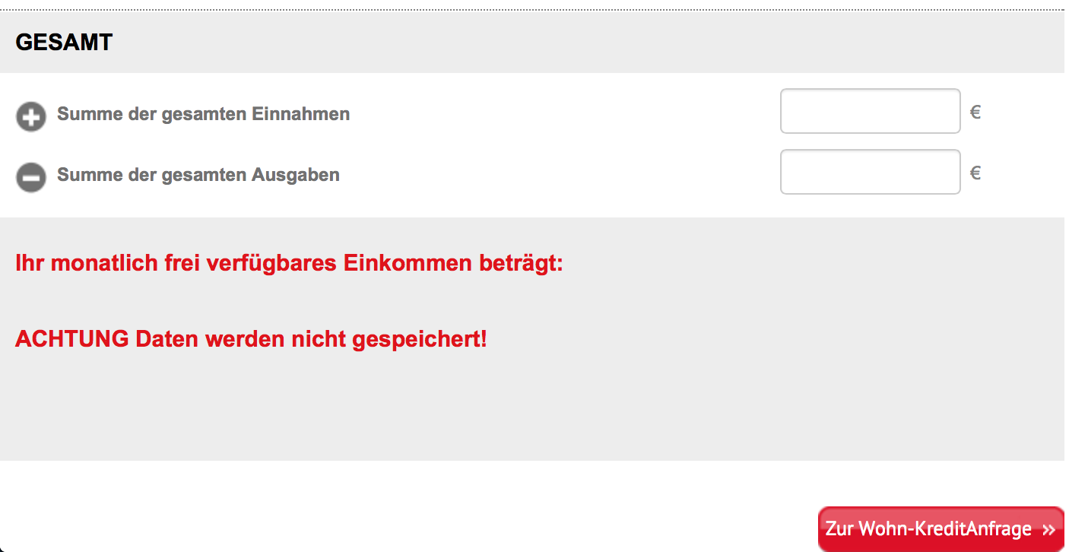
Concept Map: Budged (Cash Flow Budget)
Competences:
Creation of simple financial budgets
Proposal of actions to fill the gap in case of a negative cash flow, or to decide how to use a surplus in case of a positive Cash Flow
Assess the practical importance of budgets
What is a budget?
Plan for future activities expressed in
planned income less expenditures
Goal: support an organization or
Individual to reach financial targest and
increase in financial stability
L. 1.02 Entrepreneur H. Albrecht
3rd Quarter
202.500,00
17.750,00
13.800,00
234.050,00
-105.500,00
-82.250,00
-10.650,00
-7.450,00
-3.450,00
-4.450,00
-3.350,00
-2.500,00
-219.600,00
4th Quarter
0,00
0,00
0,00
9.500,00
Income
Total Income
Expenses
Total Expenses
Positive Cash Flow/Negative Cash Flow
Cash Flow Begin of periode
Cash accumulated
Actions to fill a gap
AktActions to use a surplus
Repayment of loan
Use for private purposes
Cash at the end of a periode
Sales revenue
Other revenues
Other income
Purchase of goods
Payroll expenses
Rent
Car expenxes
Maintenance
Marketing
Interest expenses
Other expenses
How to prepare a budteg?
Period
Income
Expenses
= + positive Cash fliow (surplus)/ - negative CF (gap)
+ Cash in the beginning of a periode
= Cash accumulated
+/- actuions to manage positive/negative CF
= Cash at the end of the periode
What to do with a gap od a
surplus?
Actions in case of a gap:
Increase income
Reduce expenses
Financing / loan
Sell assets, which are not necesary
Private sponsoring
Actions in case of a surplus:
Save for future periods
Invest in financial assets
Invest in assets for the company
Repayment of leans
Use surplus for private reasons
14.450,00
7.750,00
22.200,00
Practical inportance of
budgets?
-5.000,00
-7.700,00
Companies
States (Austria, UK, Greece,...)
Individuals: Family Budget
Bank loans
9.500,00

