Slide 1
field&sharing@venture
fast track
Your Field Mission and Celebration

Slide 2
4.& 5. field&sharing@venture your field mission & celebration
REFLECT
The SDGs
If you have already completed this activity in the Grounding Module, you can skip it or take only a minute to reflect on what you came up with then.
👉
Read through all the SDGs and reflect upon:
Which one is the most important one for you and why?
Which of the SDGs would your local community need most in your opinion and why?
What kind of organisations do you think of when you think of your chosen SDG?

Slide 3
4.& 5. field&sharing@venture your field mission & celebration
DEEPENING
Your Personal Strengths & Fields of Positive Impact
👉
Download the worksheet and work individually and in pairs.
This might further assist you in selecting interesting organizations to interview and get to know during your field mission!
This task can take between 15 - 25 minutes.

Slide 4
4.& 5. field&sharing@venture your field mission & celebration
The value of your field mission!
to get to know your local environment and your local change makers.
to express and share your values and interest with the world.
to celebrate that these initiatives are making a change in the world.
to share these cool initiatives with your peers and get to know each other.
to get an overview of what’s out there for you and your professional life.
to make connections now for possible future internships, work opportunities and professional networking!
…who knows, maybe you find your dream work place

Slide 5
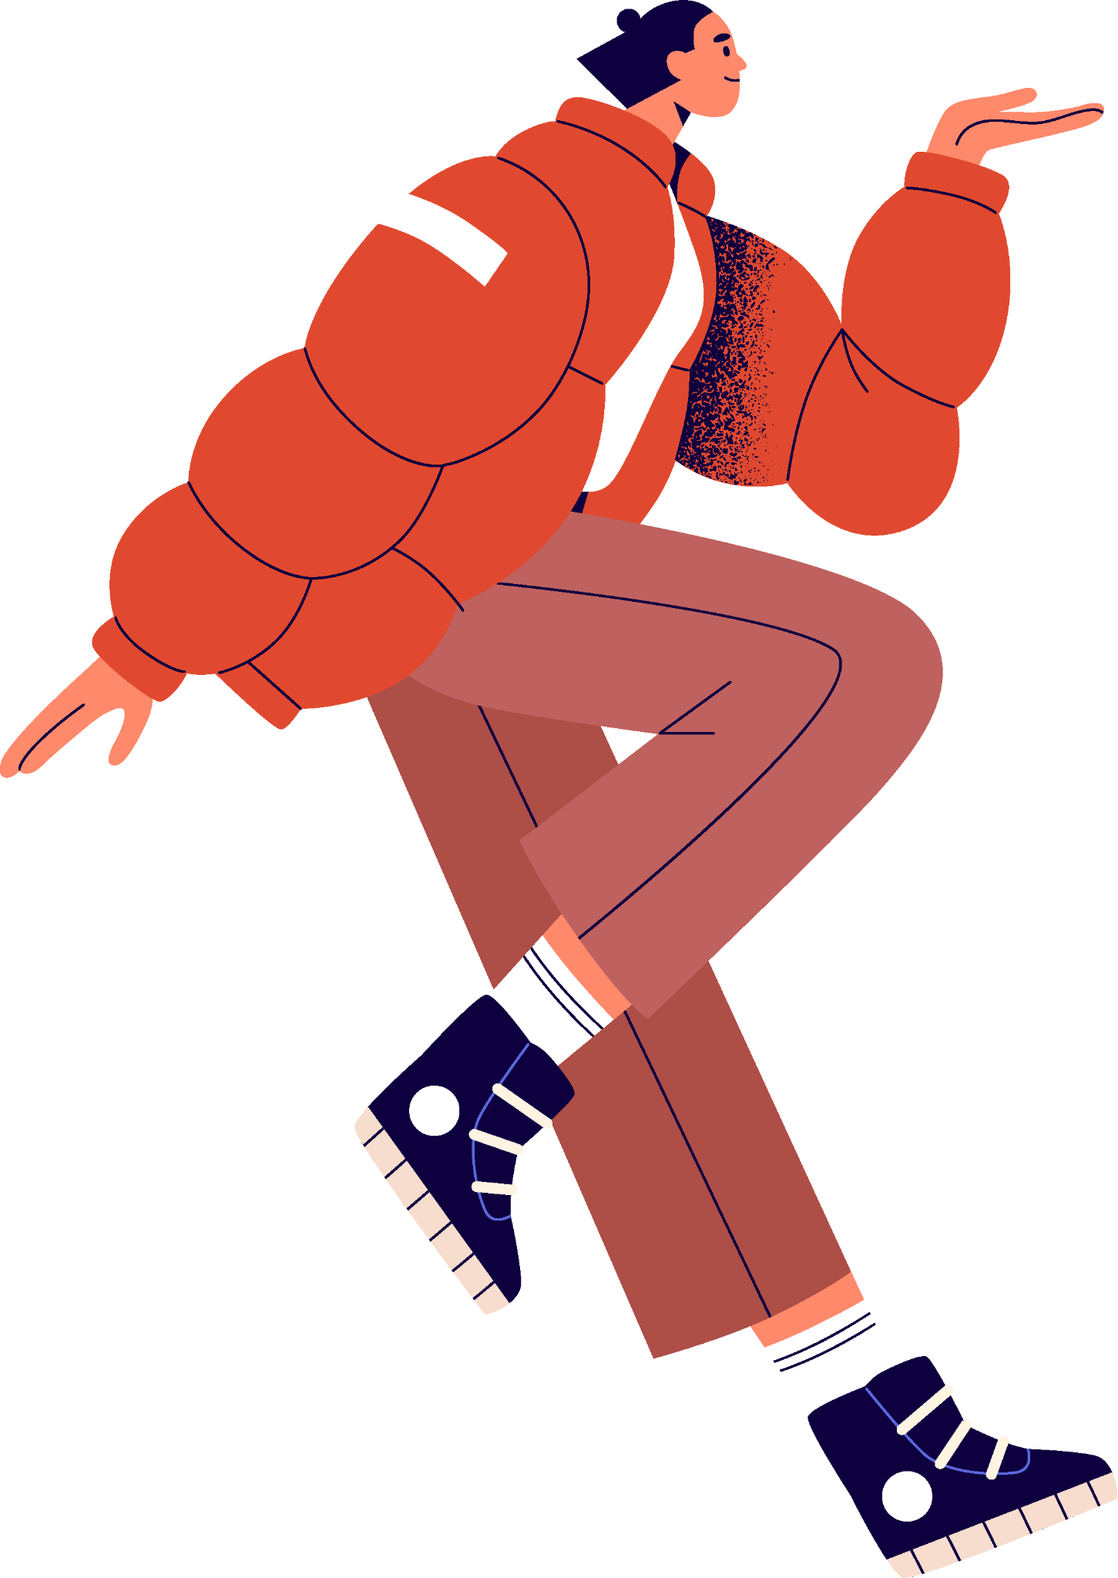
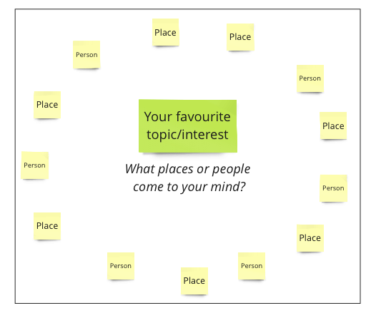
4.& 5. field&sharing@venture your field mission & celebration
Contacts for your field mission!
1. Write down a list or make a mindmap of all contacts, organisations, networks that you can think of that match your interest and are sustainable in one way or the other.
2. Now let’s harvest the intelligence of your classmates!
Download the pdf and follow instructions
Example: Interest "music". Places could be music labels, which claim to be sustainable in their travelling, with their consumption of energy, musical places etc. Contacts could be musicians, music managers, festival organisers etc.

Slide 6
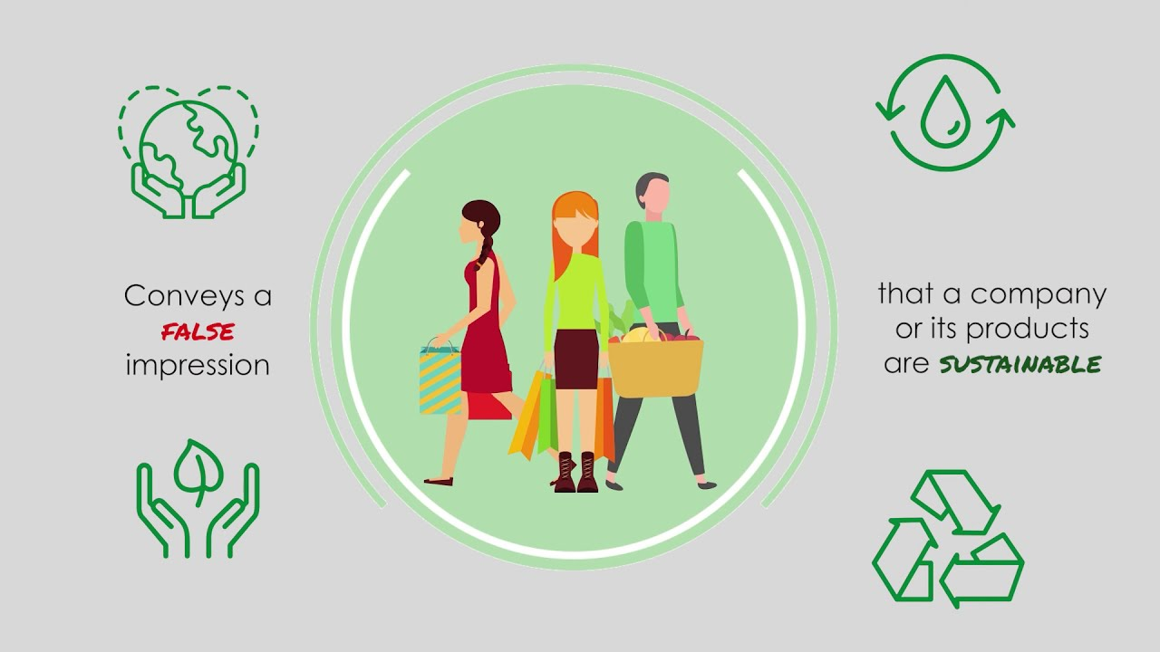
4.& 5. field&sharing@venture your field mission & celebration
DEEPENING
Greenwashing-Check!
Watch this short explanation of Greenwashing
Watch an example of advertisement that was banned due to immense Greenwashing.
🔎
Research & share three Greenwashing examples
👉
Reflect and discuss:
What can you do against Greenwashing?
Download the worksheet

Slide 7
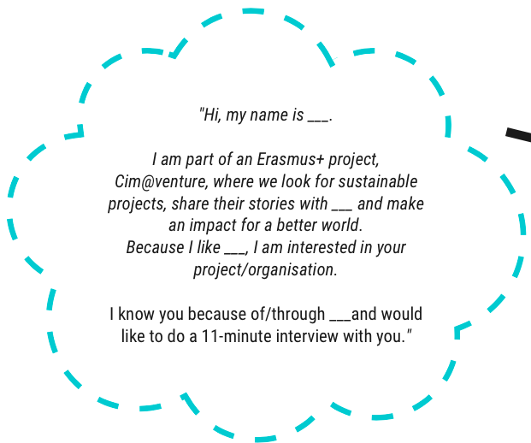
4.& 5. field&sharing@venture your field mission & celebration
Reach out!
Here is some inspiration
and some guidance how
to contact your chosen
initiatives
people
organisations

Slide 8
4.& 5. field&sharing@venture your field mission & celebration
Interviewing
Here is a suggestion of 7 interview questions you can ask. Of course this is just an inspiration, you can add your own.
How did you get involved with the topic of "XY"?
How does your organization approach this topic?
(What are the goals and the "Theory of Change"?)
What is the best part about being involved with it?
And what is not so great about being involved with it?
What changes do you see coming for the topic of "XY"?
What is needed to deal with these changes?
Do you know others who are also involved with this topic? Could you provide me with their contacts for further short interviews?
👉
Click here to find out more tips.

Slide 9
4.& 5. field&sharing@venture your field mission & celebration
Prepare for Field Mission
Practice
Pretend & Practice your interview in pairs - this helps enormously!
Bring two friends and divide roles during the field mission: one camera (wo)man, a recorder/writer and one who talks & asks the questions. Teamwork makes the dreamwork!
If you have not, check out the storytelling video in Module 3 to sharpen your storytelling skills.

Slide 10
4.& 5. field&sharing@venture your field mission & celebration
3,2,1 - field mission!
Prepare
Bring your phone and a microphone if you need.
Something to write or a recorder so you will remember their replies. If you make a phone call, switch to loudspeaker.
Bring your interview questions. If people do NOT want to be video recorded, you can also create a podcast for example instead of a video!

Slide 11
4.& 5. field&sharing@venture your field mission & celebration
3,2,1 - field mission!
You can do the short interview by:
Calling a friend, a family member or someone you know who is doing something you are interested in from school
Speaking to a class/school mate or teacher in your school
Acting out the interview with your classmate(s)
Have fun!

Slide 12
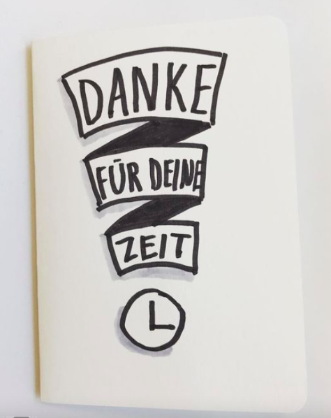
4.& 5. field&sharing@venture your field mission & celebration
Staying in touch
Show some appreciation for your interviewee’s time, so they will keep you in their memory!!
How? Get some inspiration
and a successful example of
a message of appreciation
👉
click here

Slide 13
mookie@forum-via.org
4.& 5. field&sharing@venture your field mission & celebration
Creating a Video or Podcast
Now the technical part begins:
video cutting/editing or producing a podcast.
Go back to the tutorial in Module 3, and have fun creating your piece of art of storytelling!

Slide 14
mookie@forum-via.org
4.& 5. field&sharing@venture your field mission & celebration
Show your creation & Share your story!
You can share it with your classmates, your school or your partner school (offline or online), depending on your possibilities.
You can also get creative how you want to share your creation and your story elsewhere:
Via organising a Press conference, or a pop-up exhibition or writing Articles for your local Newspaper
Via stories, reels, posts on your social Media

Slide 15
mookie@forum-via.org
4. & 5. field&sharing@venture your field mission & celebration
Get your Certificate from your teacher!
..and celebrate successfully completing the Clim@venture Program and therefore having mastered valuable capabilities and skills to co-create a sustainable future and contribute to the 1.5 climate goals of the Paris agreement as an active European citizen.

Slide 16
4.& 5. field&sharing@venture your field mission & celebration
Help us improve the Clim@venture
Go through the questions and collect your thoughts.
1. What were the challenges during the process of this project?
2. What would you have needed for better understanding? 3. What did you like about the experience the most?
4. How can we improve the content and the visuals?
5. How did this project help you learn more about Climate Action?
6. Which Module could you learn most of? What was too short or too long?

