Slide 1
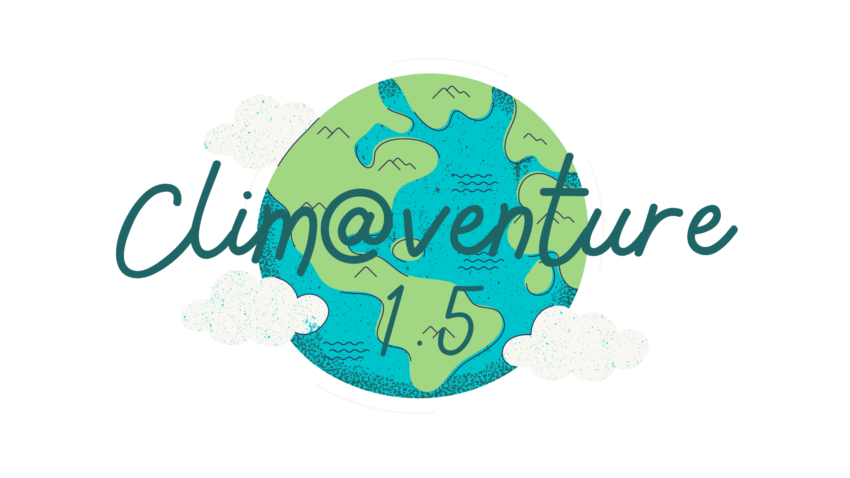
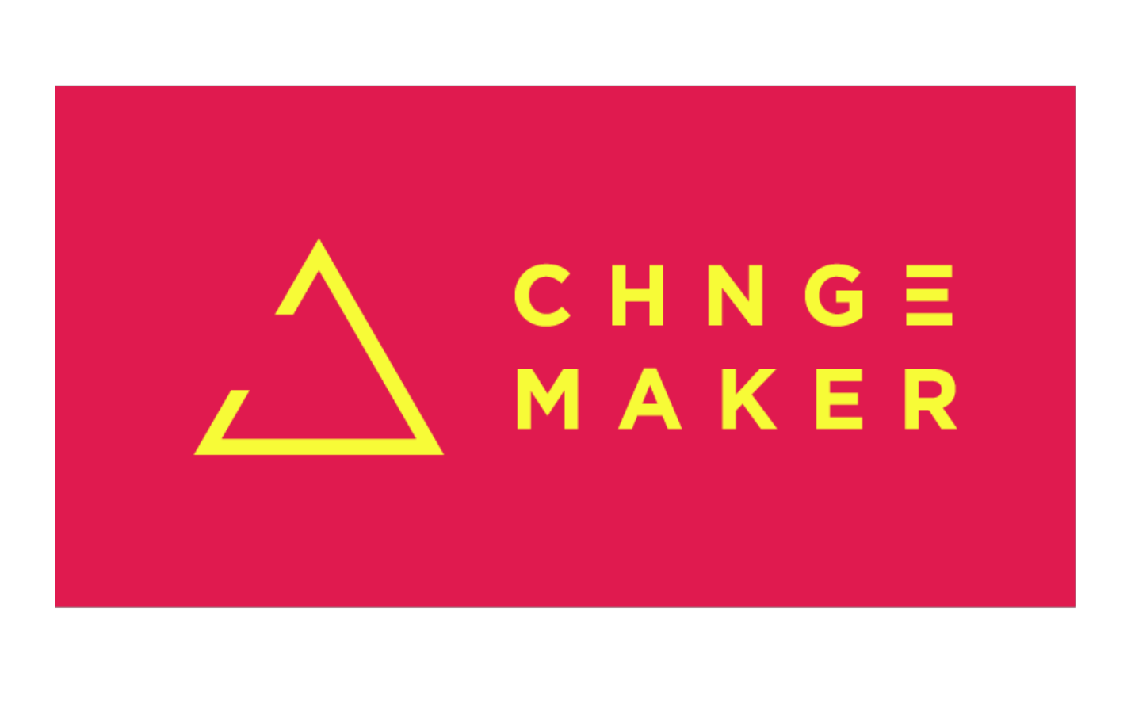
journalist@venture
How To Become
a SDG Reporter

Slide 2
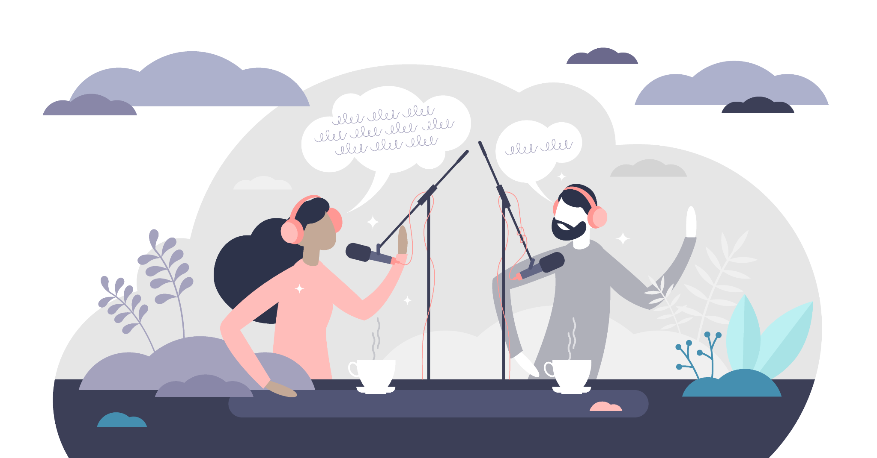
3.1 journalist@venture How to become a SDG reporter
Get ready to learn what why storytelling is crucial and how to catch everyone's attention with it, how to conduct a good interview and how to follow up on it and prepare the results in form of a video or podcast.

Slide 3
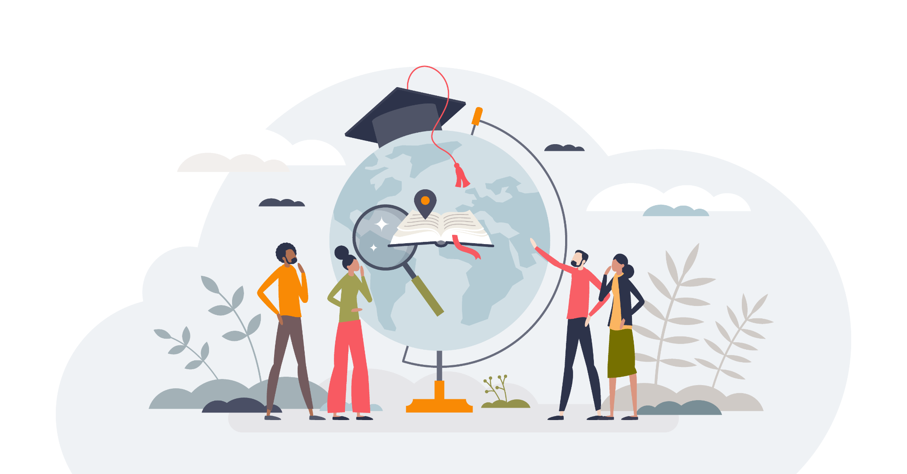
3.1 journalist@venture How to become a SDG reporter
Then you will go on a micro-adventure, visit and interview a sustainable initiative of your interest and choice. And put everything you learned into practice!
Ready? Let’s get it started!
The adventure is waiting for you!

Slide 4
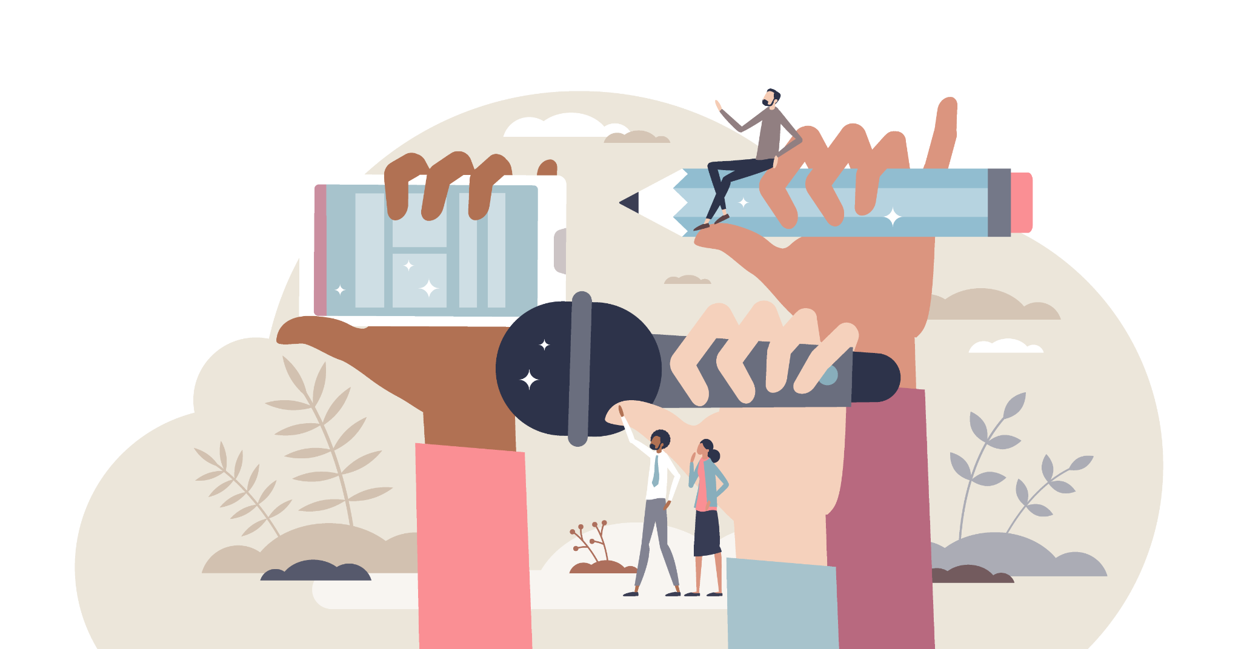
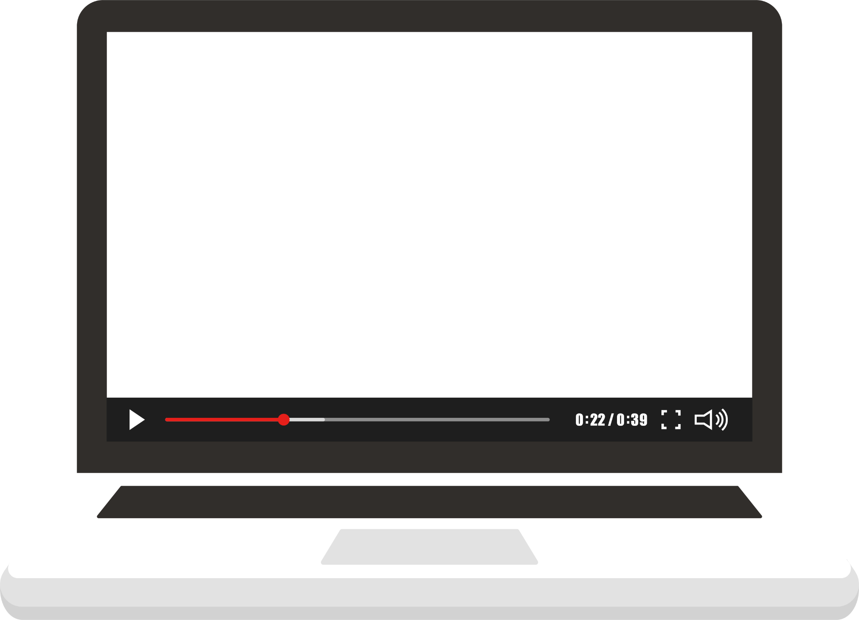
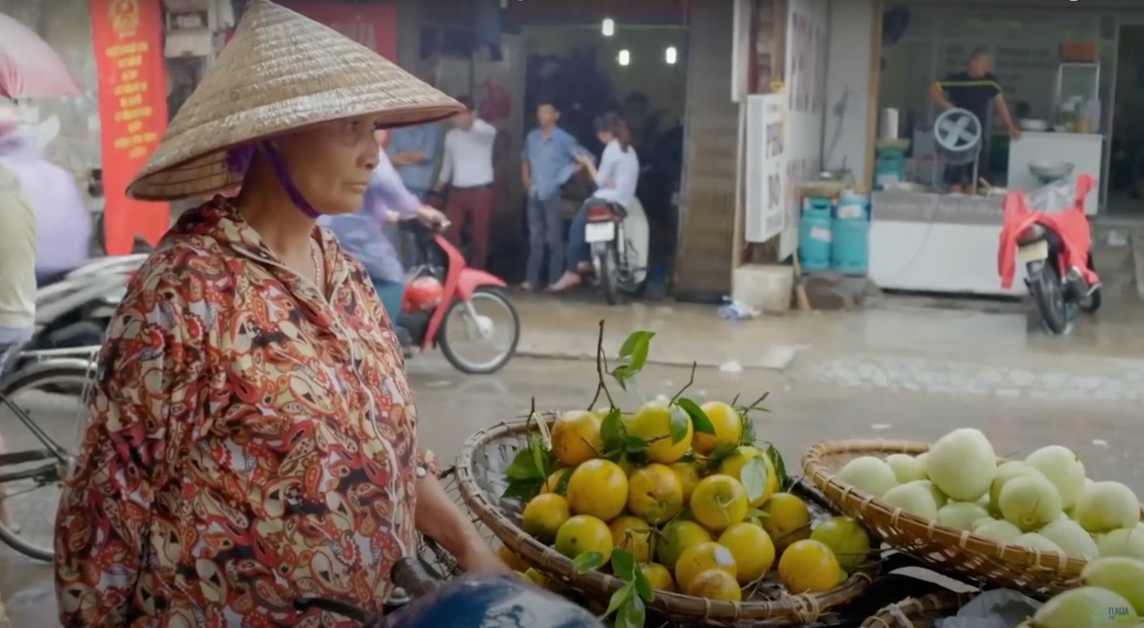
3.1 journalist@venture How to become a SDG reporter
The Art of Storytelling
In this video you will learn how environmental and constructive journalism works and to get you ready to become a SDG reporter yourself!

Slide 5
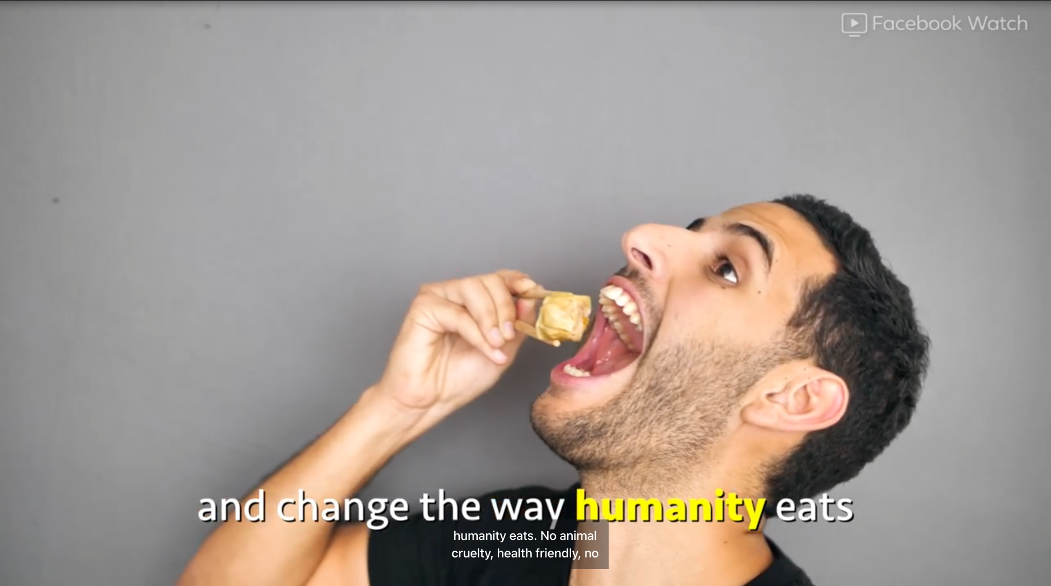
3.1 journalist@venture How to become a SDG reporter
A Powerful Example of Storytelling
Watch and think about following questions before discussing it with the rest of the class:
What stands out in the video?
How is Storytelling used here?
What are your takeaways from it?

Slide 6
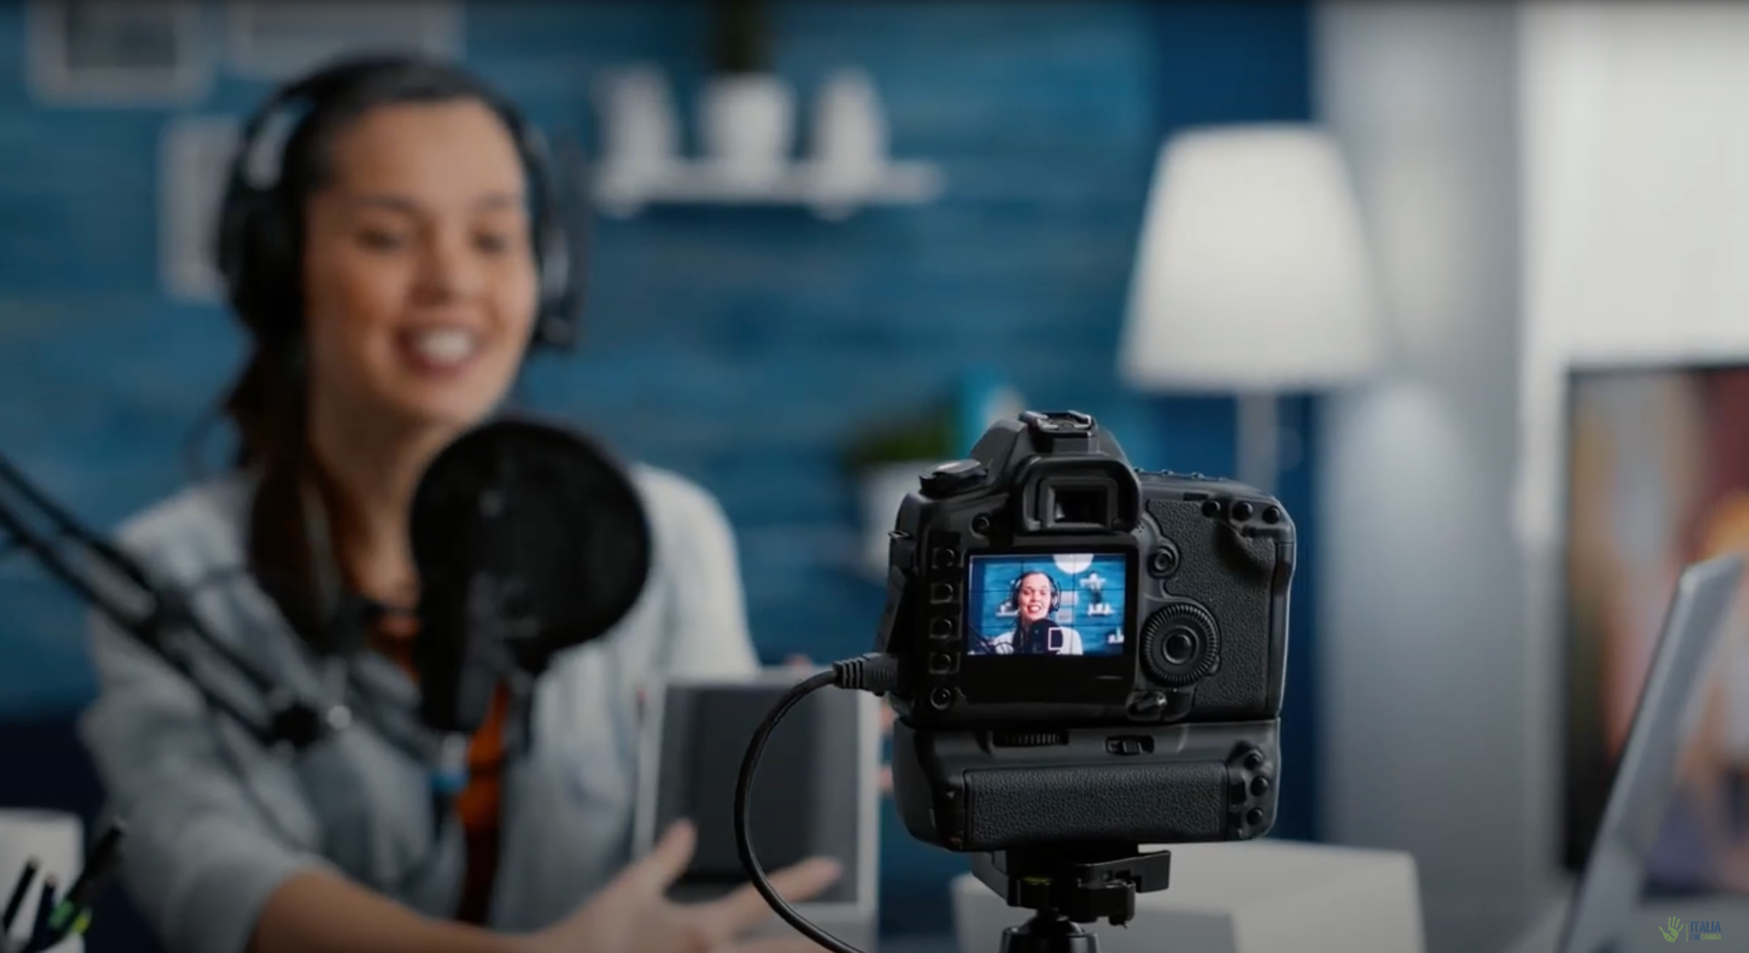
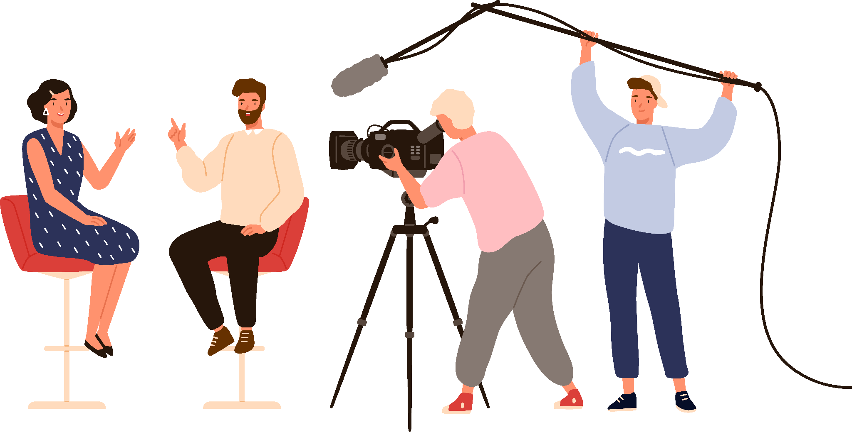
3.1 journalist@venture How to become a SDG reporter
THEORY
How to do a good interview
In this video you will get the basic knowledge on how to conduct a good interview and what you have to prepare and think of beforehand

Slide 7
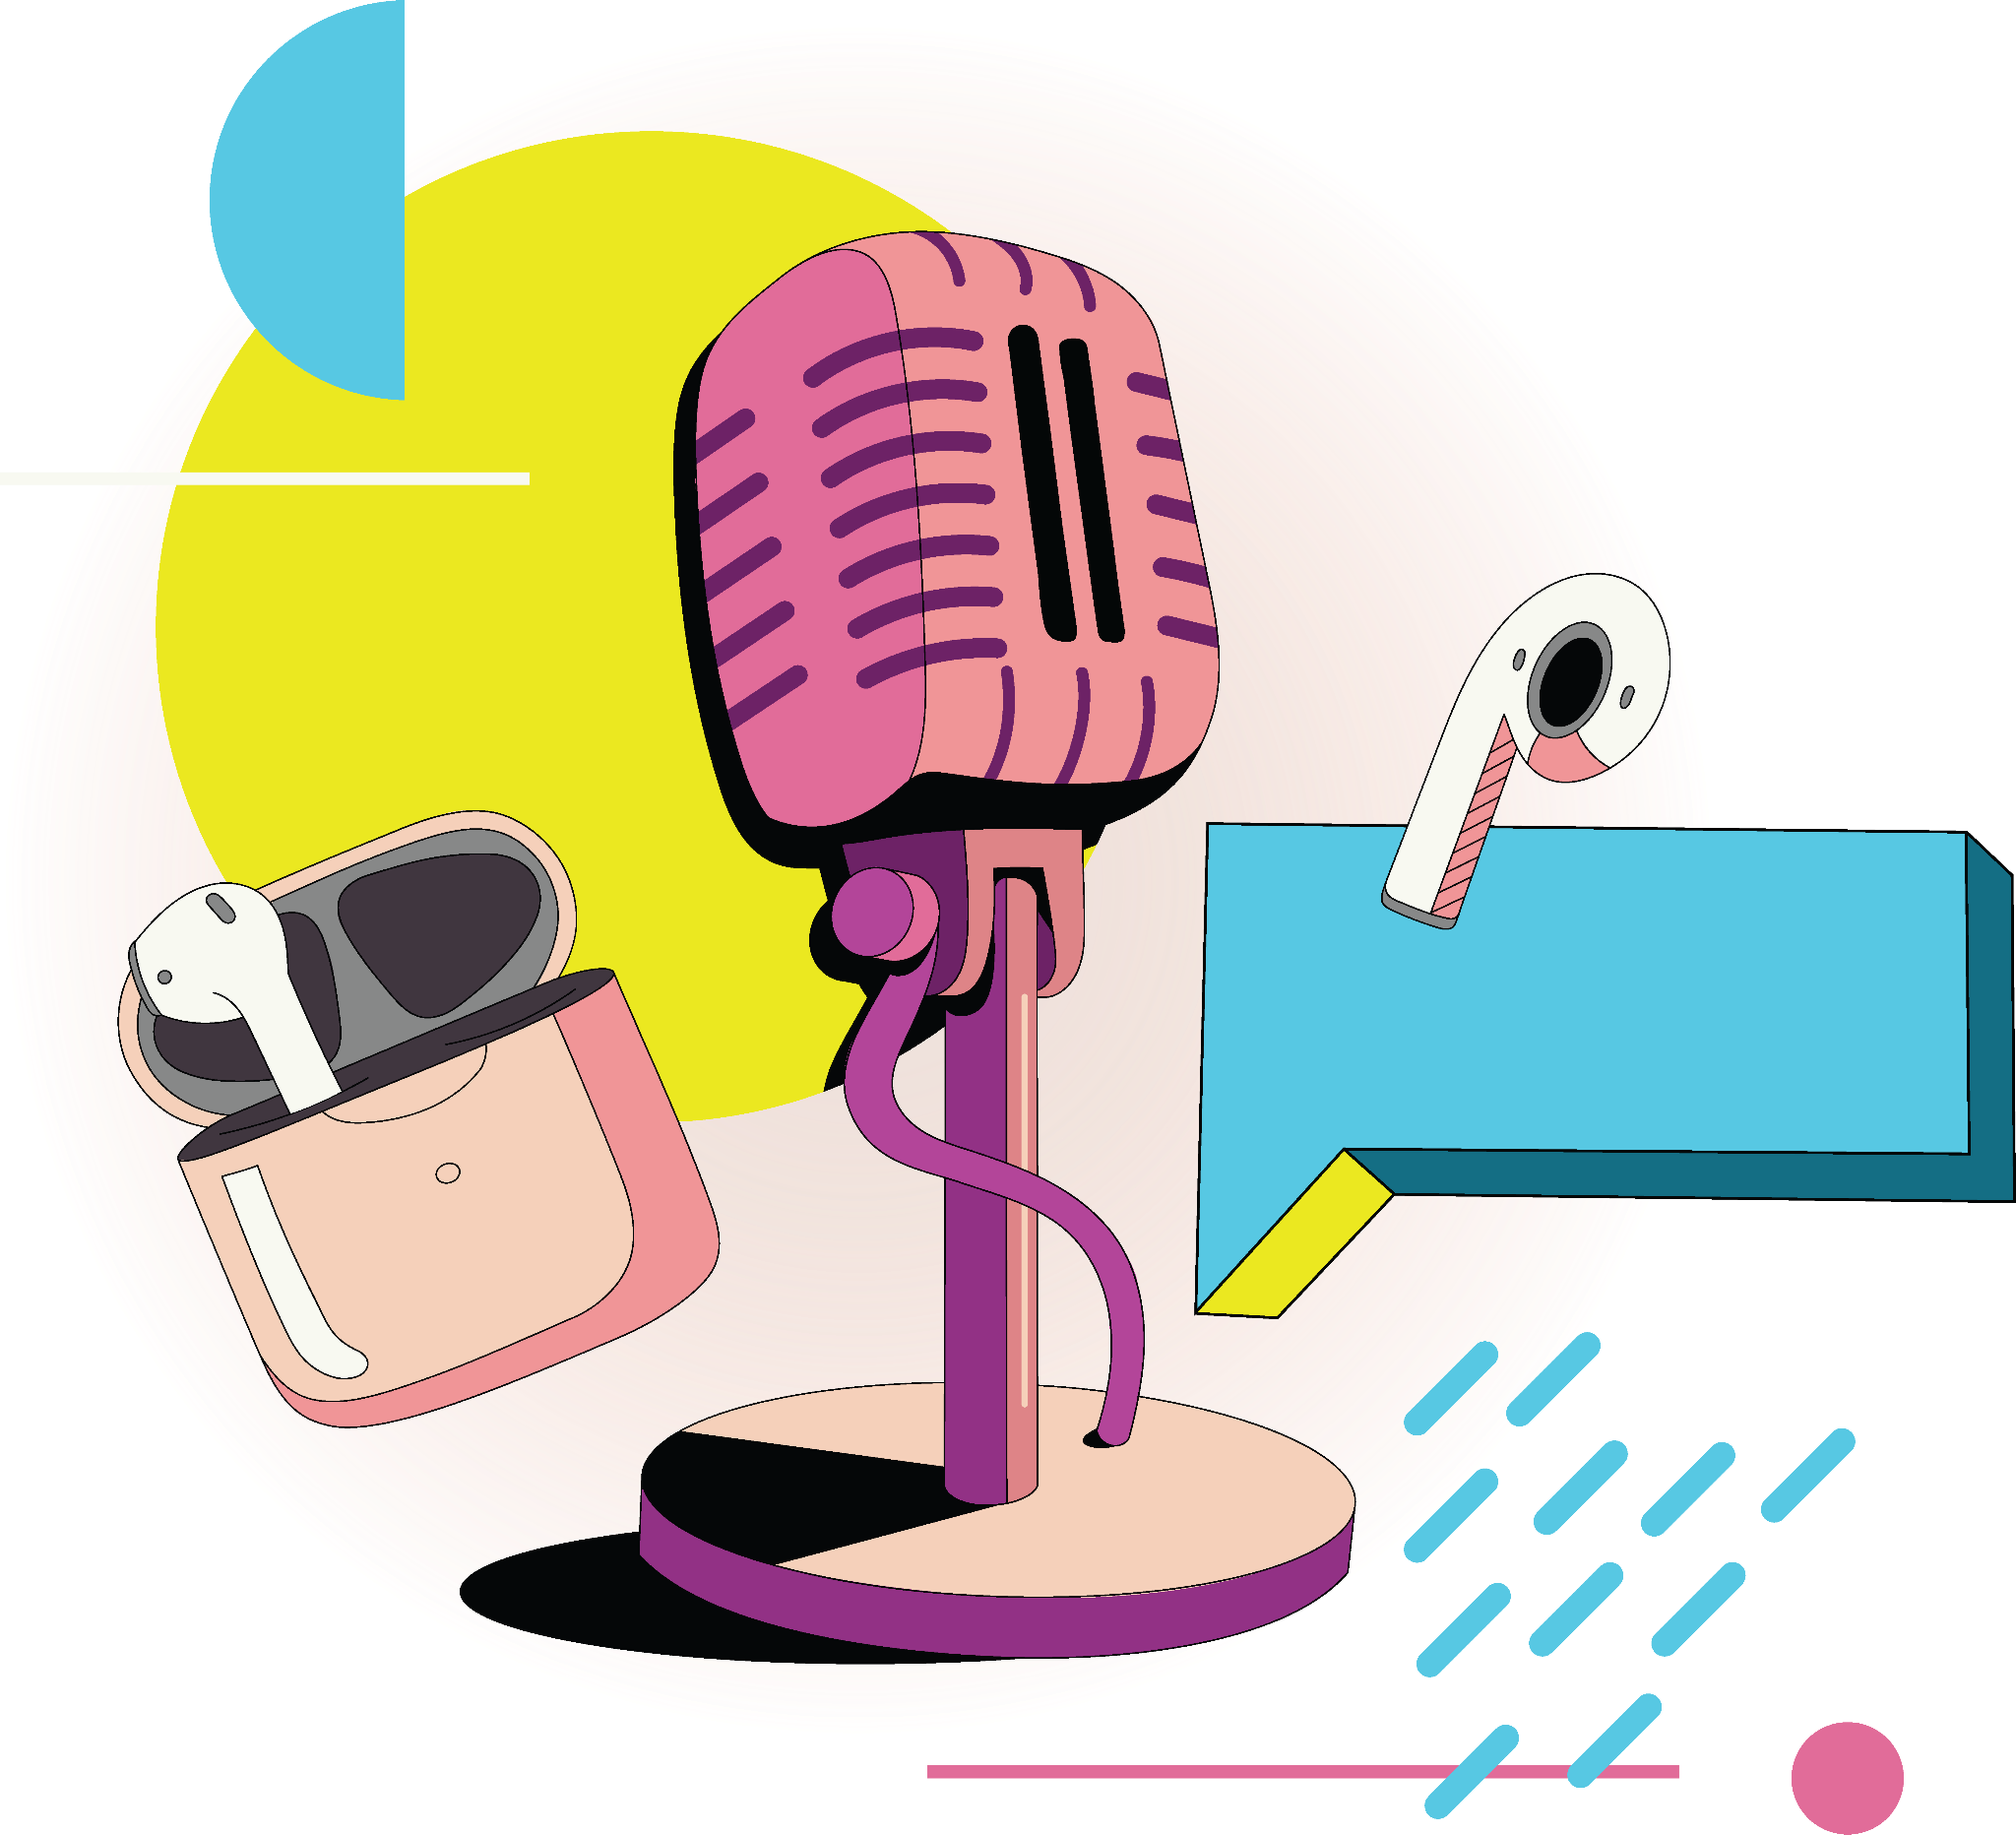
3.1 journalist@venture How to become a SDG reporter
TUTORIAL
How to create a good video and podcast
In this video you will get the basic tools on how to create a good audio or video content.

