Slide 1
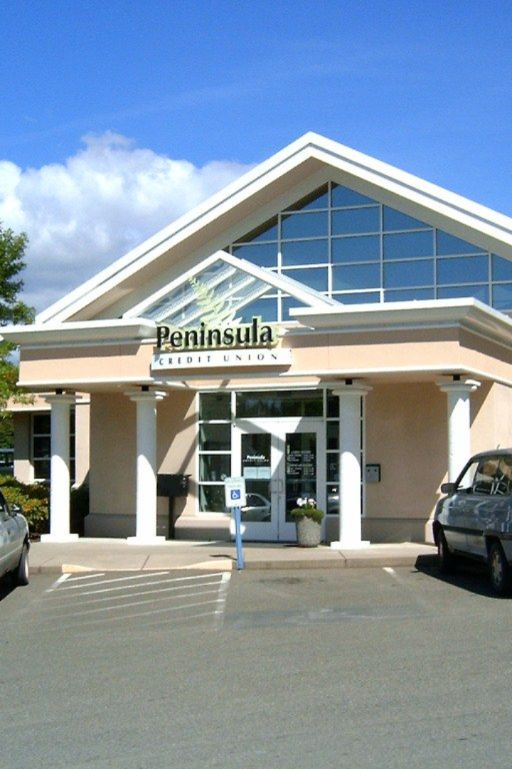
Introduction to Signa Holding and Reno Benko
Signa Holding, led by Reno Benko, is a prominent real estate and retail investment company headquartered in Vienna. The company has a diverse portfolio of high-value properties and retail brands across Europe, making it a key player in the industry.
by Werner Holzheu

Slide 2
Overview of the financial problems in 2023
Market Turbulence
Operational Setbacks
Liquidity Issues
The year 2023 brought significant financial challenges, including market turbulence and economic instability, impacting various industries and companies globally.
Signa Holding faced unforeseen economic hurdles, leading to operational setbacks and financial constraints in the form of reduced profitability and growth.
Liquidity concerns emerged, compounding the financial problems and necessitating strategic measures to ensure sustainable operations.

Slide 3
Factors contributing to the financial problems
Economic Downturn
Industry-specific Challenges
The widespread economic downturn, influenced by global events, played a pivotal role in exacerbating the financial challenges faced by Signa Holding.
Specific industry-related obstacles, such as supply chain disruptions and shifting consumer behaviors, added complexity to the financial landscape.
Regulatory Impacts
Changes in regulatory frameworks and compliance requirements also contributed to the financial strain, requiring adaptive strategies.

Slide 4
Impact on Signa Holding's operations and performance
1
Revenue Decline
Marked reduction in revenue streams led to challenges in maintaining operational stability and investment momentum.
2
Market Positioning
The company's competitive positioning and market influence faced strain due to the financial constraints and evolving market dynamics.
3
Employee Engagement
Employee morale and engagement were affected due to the uncertainties surrounding the company's financial situation, necessitating holistic support measures.

Slide 5
Strategies implemented to address the financial problems
1
Cost Rationalization
2
Asset Optimization
Strategic cost-cutting initiatives were employed to streamline operations without compromising long-term growth prospects.
Efforts focused on optimizing the existing asset portfolio and exploring avenues for asset value enhancement and utilization.
3
Partnership Expansion
4
Debt Restructuring
Forming strategic partnerships and collaborations to diversify revenue streams and foster mutually beneficial growth opportunities.
Engagement in proactive debt restructuring to alleviate financial burdens and pave the way for sustainable financial health.

Slide 6
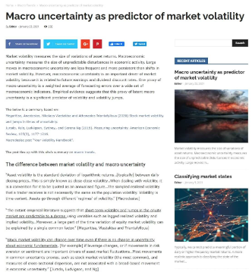
Challenges faced in resolving the financial problems
Market Uncertainty
Stakeholder Confidence
Economic Volatility
Navigating through unpredictable market conditions and their impact on strategic decision-making and investment planning.
Adapting to economic volatility and leveraging flexibility to address financial uncertainties while maintaining operational resilience.
Rebuilding and sustaining stakeholder confidence amidst the financial challenges and restructuring endeavors.

Slide 7
Future outlook for Signa Holding and Reno Benko
Resilience & Adaptability
Embracing resilience and adaptability to navigate through dynamic market landscapes and emerge stronger from the financial turbulence.
Innovation Focus
Shift of focus towards innovation-driven strategies and forward-thinking approaches to drive sustainable growth and prosperity.
Strategic Expansion
Exploring strategic expansion opportunities and venturing into emerging markets to diversify revenue sources and enhance market presence.

Slide 8
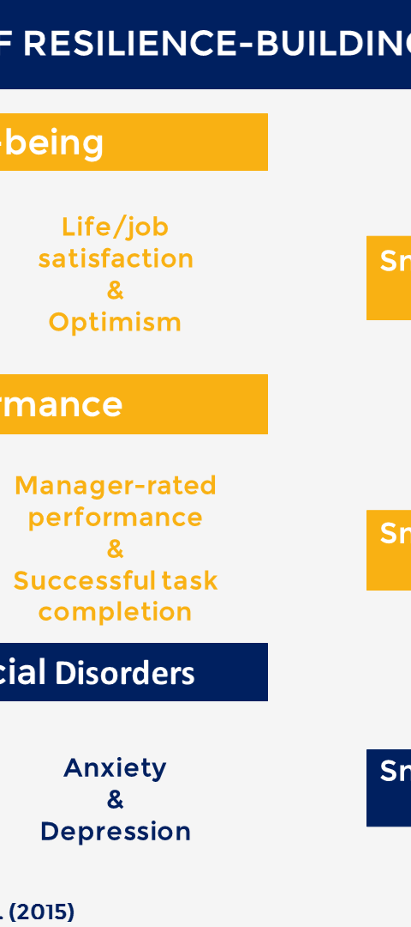
Conclusion and key takeaways
Optimism Amidst Challenges
Leadership Commitment
Despite the adversities, the company maintains an optimistic outlook and is committed to surmounting the financial hurdles with resilience.
Reno Benko's steadfast leadership and strategic vision remain pivotal in steering the company towards stability and sustainable growth.
Adaptive Strategies
Embracing adaptive strategies and fostering an agile organizational culture to thrive amidst evolving financial landscapes and industry dynamics.

