Slide 1
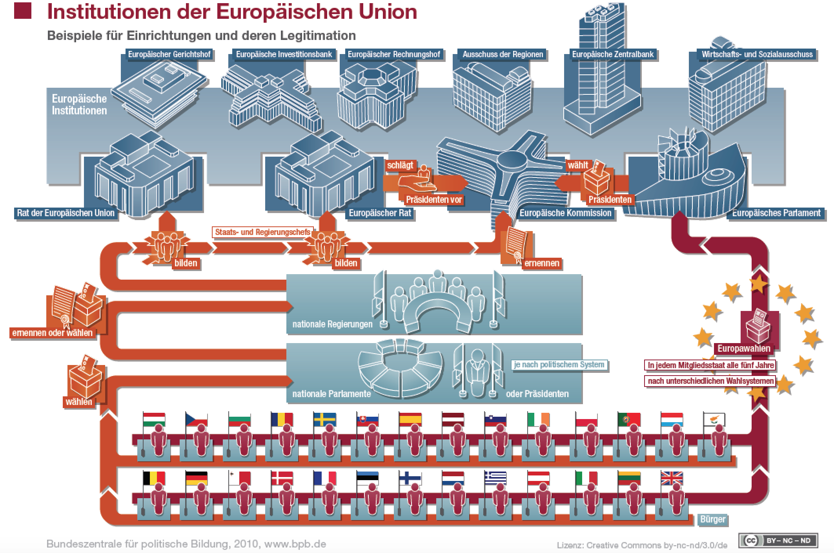
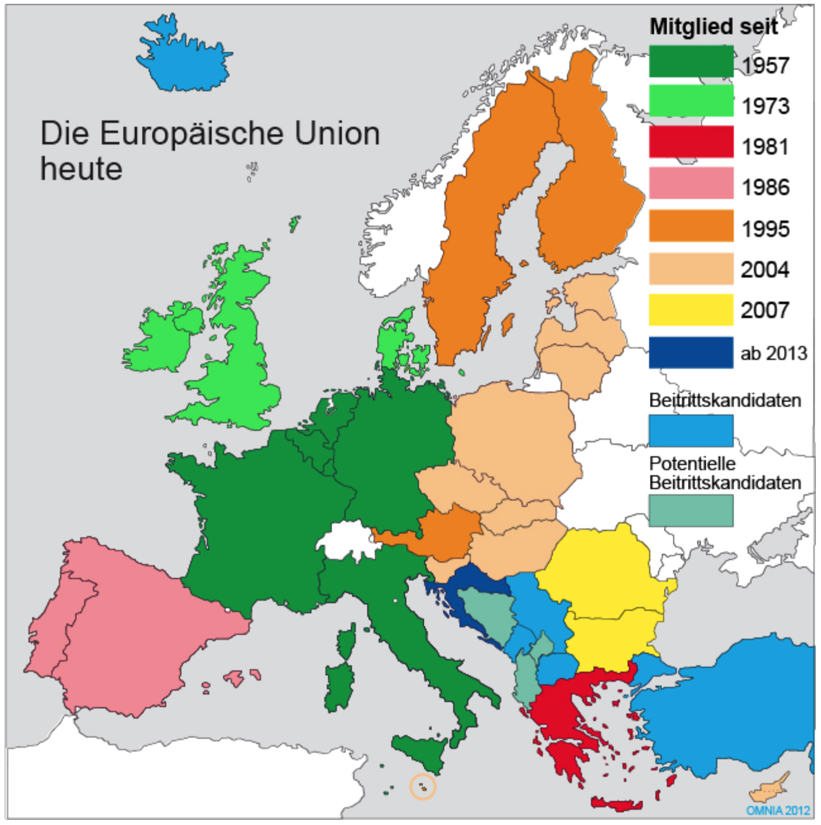
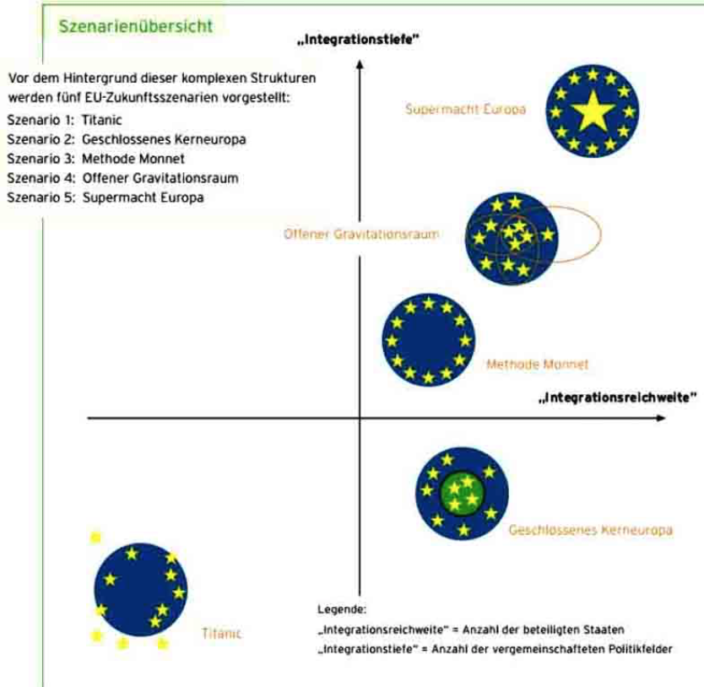
European Union
Competencies: Being able to describe institutions, tasks, current development scenarios, advantages and disadvantages of monetary union,
European Council: highest body of the EU (Heads of State and Government + President of the Commission) > defines political objectives
Council of the European Union (Council of Ministers) main legislative and decision-making body > decides on proposals from the Commission
Commission: a body independent of Member States, representing all interests internally and externally (EU Government), composed of 28 Commissioners, responsible for proposing legislation
EU Parliament (751 MEPs directly elected by citizens, for 5 years each, meet in Strasbourg and Brussles) Are divided into political groups, Enquiries & control, vote of confidence and mistrust from the Commission Budgetary decisions and legislative co-decisions (Council of Ministers)
EU Court of Justice: (Luxembourg) = EU body responsible for jurisdiction, "Guardian of the Treaties".
European Court of Auditors: compliance with the principles of the expediency and regularity of the sound financial management of the Community budget
Committees for Economy & Social Affairs: various Groups from for Economic & Social Issues Regions: Local & regional representatives for citizen proximity
Origin in Greek mythology: Europe (Phoenician princess) fell in love with Zeus after he had kidnapped her as a transformed bull. The area where the two had lived was later called Europe, Europe was over the centuries the scene of many armed conflicts (1st WK, 2nd WK, etc.), 1950 Robert Schumann: Economic Cooperation Better than War
1952: Foundation (Schumann, Adenauer,...) 6 states (D,F,I,Benelux), ECSC, EURATOM, EWG, ..... 1959 and. European countries Foundation EFTA
1967: Formation of the EC with main organs: Council, Commission, Parliament, Council of the EU, ECJ, EURH, from 1968: Customs Union ... Association agreement with Turkey, etc. Countries
1972 European Monetary System, preliminary stage Euro, 1973 Enlargement UK, IRL 1979 Direct election EU Parliament Free trade agreement with EFTA countries,
1980s 4 freedoms (movement of goods, services, establishment, capital), 1981+86 extension Spa, Port, Gr, 1985 and 1990 Schengen Agreement: Abolition of border controls
1992 Maastricht Treaty: foundation of the EU, internal market + defence and security policy, 1995 Öst, Schwe, Finl become members, 1999 start of the monetary union, 1999 Treaty of Amsterdam asylum, migration and visas > EU
2000 fundamental rights, 2001 constitutional decision, 2002 euro as cash, 2004 enlargement to include Poland, Slovakia, Hungary, Slovenia, Malta, Cyprus Estonia, 2007 accession of Romania, Bulgaria, 2007 Treaty of Lisbon (reforms, constitution, ...) , 2009: concept of constitution and new treaty is abandoned, 2010 rescue umbrella, ESM stability pact, 2012 Nobel Peace Prize for EU 2013 Croatia accession, 2016 Brexit referendum
Current Juncker Plan March 2017
Continue as before: slow small progress, warning experience refugee crisis
Focus on the internal market: only economic cooperation, because more is not possible, but the gap between expectations and reality is widening.
Who wants more does more: Europe of different speeds, increased complexity, law depending on which citizen you are...
Less but more efficient: Concentrating on what could be well regulated together, e.g. border protection, withdrawal from regional activities, health,...
Much more joint action: more power to Brussels at all levels, means renouncing local influence
Basic Stages of integration and economic cooperation
Economic cooperation
Free trade area: no customs duties between own regulations and to 3rd countries (EFTA, NAFTA, CETA, TTIP)
Customs union: no customs duties between 3. country, EU+Tü, Mercosur
Internal market: Common market, harm. Wipol, supranat Law
Economic union or economic and monetary union: according to market, + according to Wipol, + according to law, + according to currency, euro zone
Political Union: common foreign and security policy, common defence policy,...
Member states become federal states
Future scenarios of the EU 1992:
Titanic
Closed Core Europe
Monnet Method
Open gravitational space
Superpower Europe

Slide 2
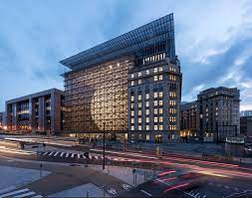
European Council
Competencies:
Definition and Facts:
The European Council defines the EU's overall political direction and priorities. Leaders of the EU-Members meet at least 4 times a year. These meetings are rather informal, because the Officials of the Members are not on the spot. For example they call each other by their first name. Since 2009 the European Council is an official institution. The current president ist the former Prime Minister of Belgium, Charles Michel.
Where does it take Place?
Since 2009 the Meetings take place in Brussels, in the Europa Building. There was an inofficial prodecessor which took place in a different country each year.
What are they doing?
It is not one of the EU's legislating institutions, so does not negotiate or adopt EU laws.
Instead it sets the EU's policy agenda. It usually adopts 'conclusions' during European Council meetings which identify issues of concern and actions to take.

Slide 3
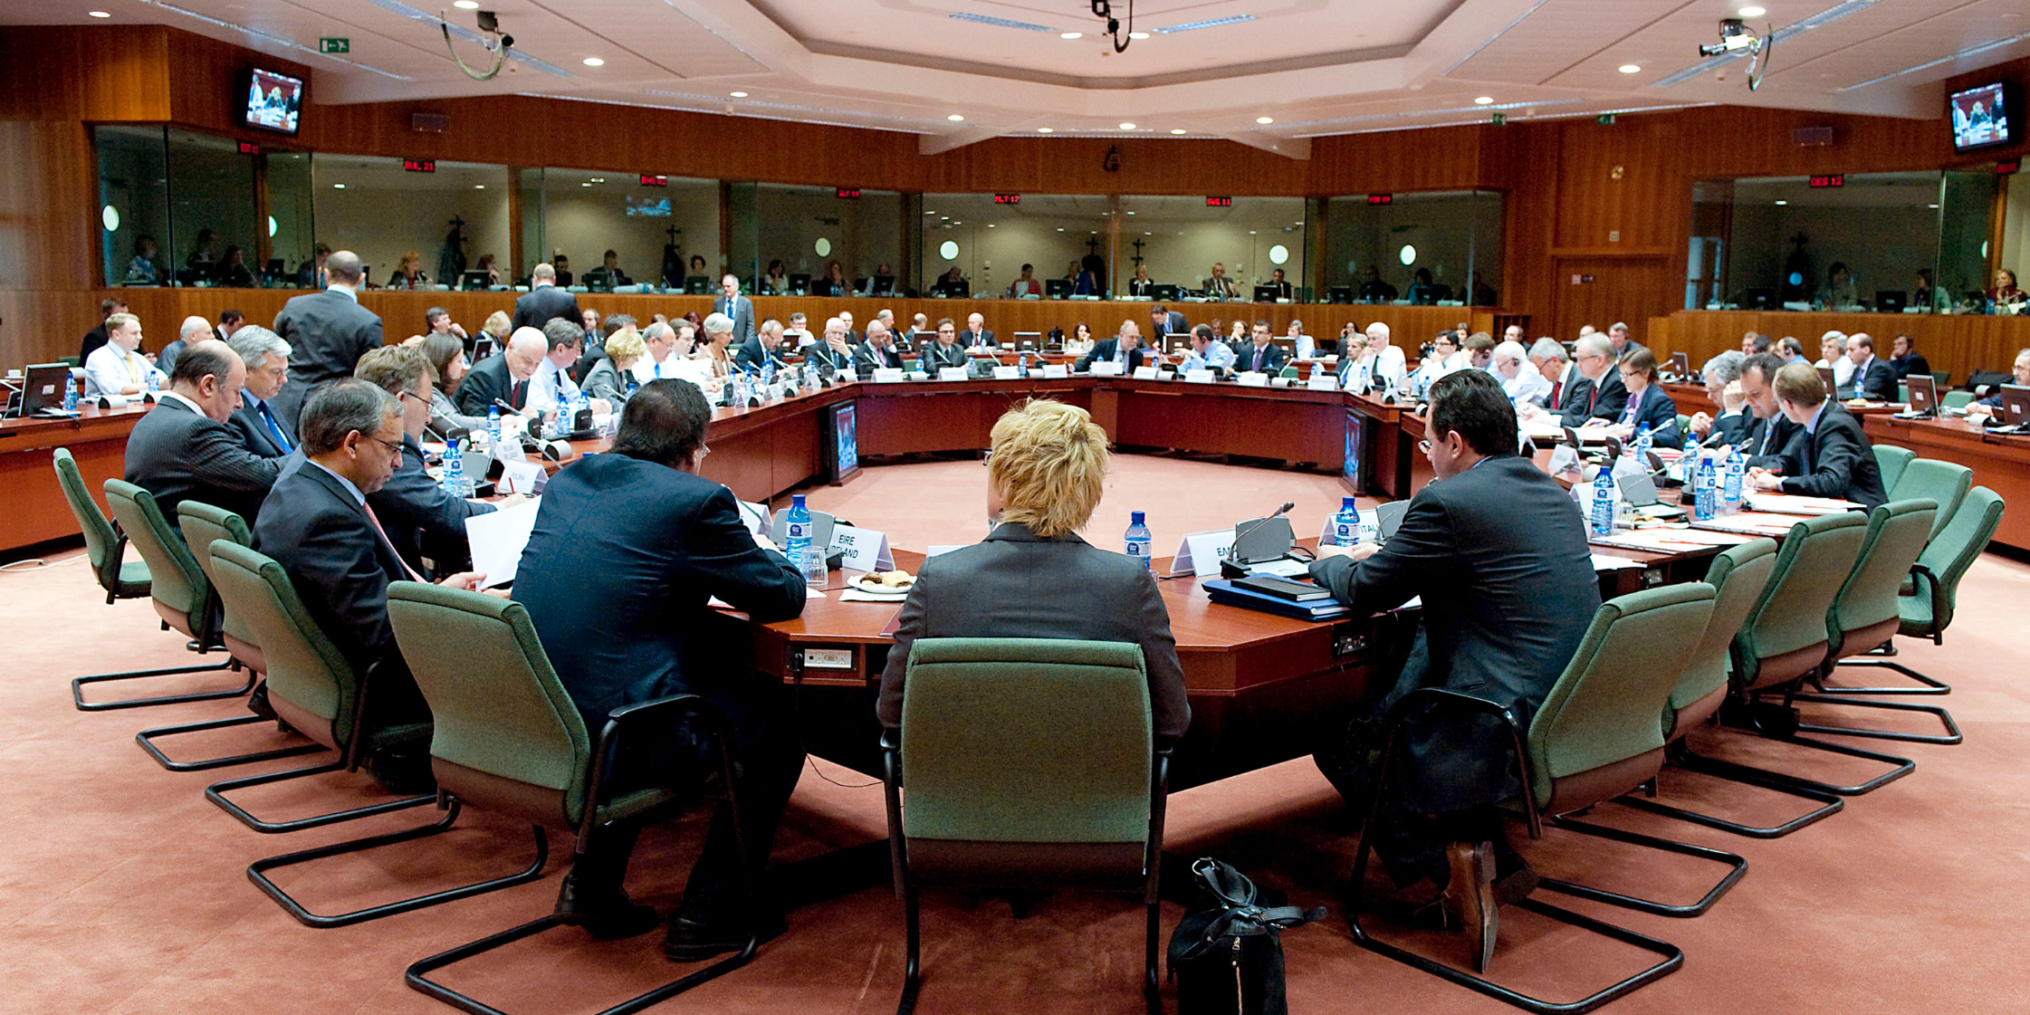
European council of ministers
Competencies:
At the "European Council of Ministers" ministers from all over the world meet in various formations. = main legislative of the EU.
President's role - facilitator and mediator
Aim: reach a consensus and reach decisions on a high level
Challenge: chairing a meeting in other languages, good preparations is essential
Important: Knowing the backround of other positions; understand other sides

Slide 4
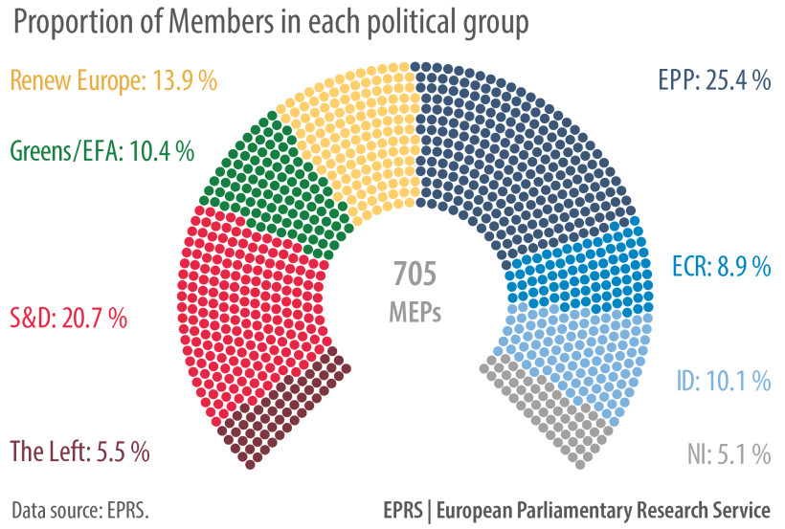
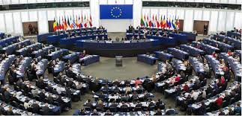
European Parliament
Competencies:
EU was first elected in 1979
Every 5 years new parliament members are elected by the european people.
Plenery meetings-> Brussel
Administrative meetings-> Luxembourg
Other meetings-> Strasbourg
Tasks:
Legislative power -> approve, reject or amend proposals
Budgetary power-> EU budget approved before spent, afterwards money discharged, after checked if it´s being spent on the right things
Control over the executive branch (the comission)
EU ≠ state parliament
EU= democratic
Voting with thumb up/down, but the absolute decision making is made by the MEP (modern european parliament)
Also electronic voting is possible
Chairman of plenery vote cannot vote theirselves
Important decisions need majority of voting
For a proposal to be considered-> need at least 50,1% (½) of the votes
For a proposal to be realised-> need at least 66,% (2/3)

Slide 5
European Law
Competencies:
4 steps for EU laws: have an idea for a law, make a draft for it, officially propose it (only Comission may do that), have it accepted
Next steps:
-Comission + help of experts drafts a proposal
-Proposal is reviewed by council & parliament & open for objection from national parliaments
-passes process
-comes into force immeadiately
Inofficially proposal can be made by:
-European comission
-European parlament
-Council
-Any EU citizen
-A quarter of member states
-Depending on the subject:
-EU Court of Justice
-European Investment Bank
-European Central Bank
3 forms a new EU-law can come in:
-Decision
-Regulation
-Directive

Slide 6
European Commission
Competencies:
The main executive body of the EU
The commissioners are supposed to work in the interest of the EU, not their own home country!
President
7 Vice Presidents
20 Commissioners
Tasks:
Propose Legislation
Enforce European Law
Set objectives and priorities for action and work towards delivering them
Manage and implement EU policy and budget
Representation in and outside the EU

Slide 7
Council of Europe
Competencies:

Slide 8
Council of European Union
Competencies:

Slide 9
Court of Justice
Competencies:
The European Court of Justice is ensuring that EU laws are respected. It is split up into 2 distinct courts.
Court of Justice | General Court
one judge from each EU member state (28) | more judges
each case allocated to a chamber | Cases by individuals and companies
number of judges = importancy and complexity of case | number of judges = importancy and complexity of case
Advocate General = give their own legal solutions before judges decide | Wide variety of matters, f.e. trademarks, competition laws, agriculture
tell national judges how to interpret EU laws
settle disputes between different EU institutions
In both courts it`s allowed to speak in any EU language and translation is provided.

Slide 10
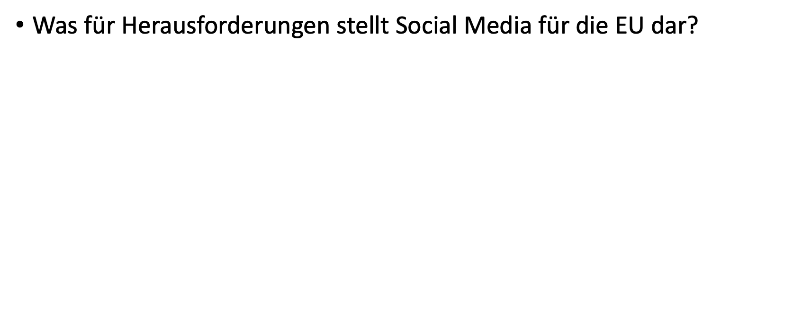
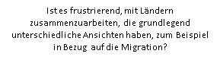
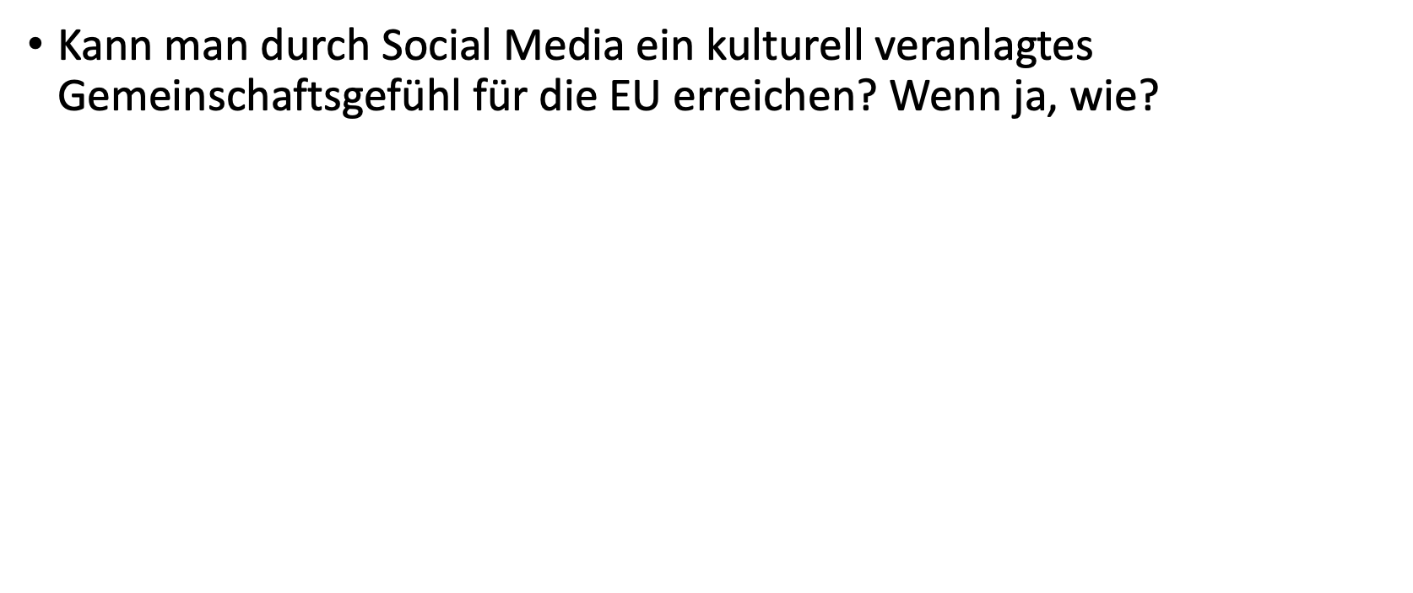
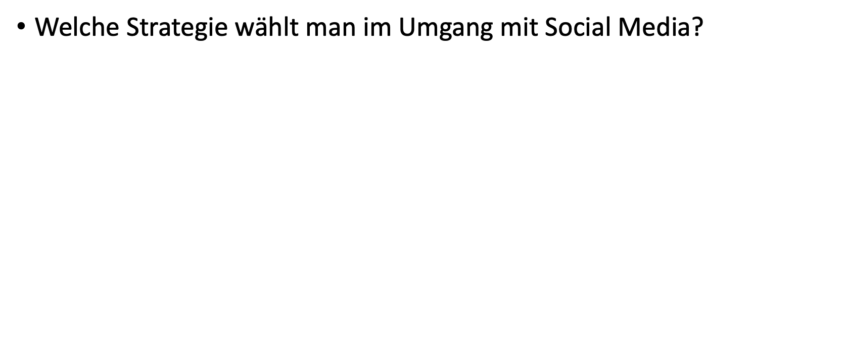
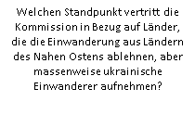
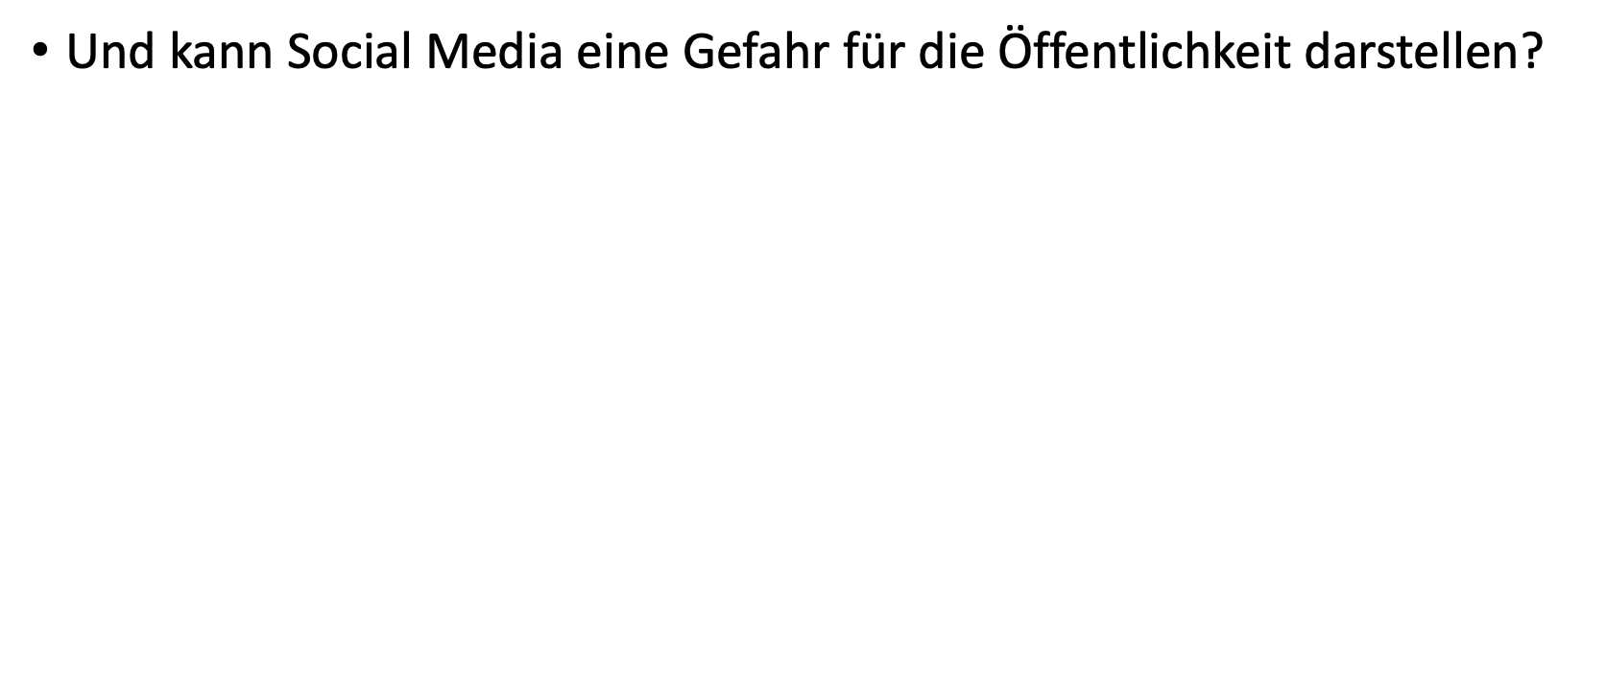
Questions
Karas: Parliament
Commission:
Social Media
Commission:
Migration
Austrian
Embassy

