Slide 1
Team Teaching
Introduction to
Economics
What do we already know about economics?

Slide 2
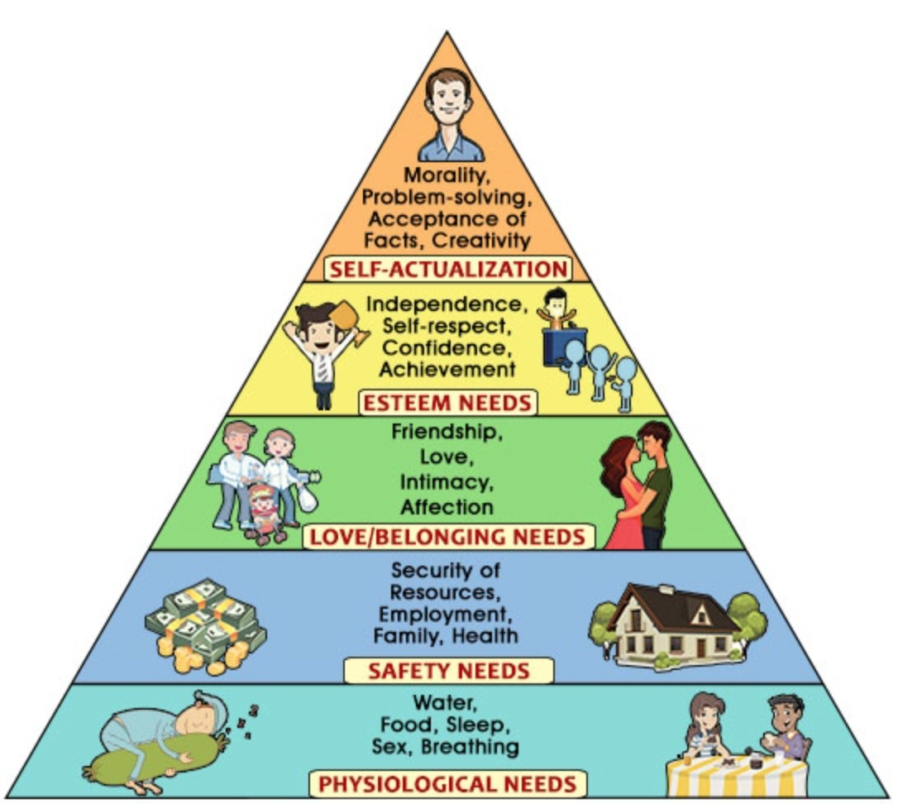
Needs
Human needs are endless!
Abraham Maslow (a 1950s US psychologist) grouped all human needs according to their urgency:
5) Self-actualization: morality, creativity
4) Esteem needs: independence
3) Love / Belonging needs: friends
2) Safety needs: security, health
1) Basic needs: water, food, sleep
Demand: everything customers have the buying power for

Slide 3

Sustainability
Resources are scarce: we have only 1 planet
→ we have to take care of our planet and live sustainably.
Sustainability:
Resources (factors of production) are used to produce goods.
The purpose of goods is to meet our needs.
Because resources are scarce, we have to make decisions.
2 principles apply:
1) Minimum Principle: to reach a given goal with the minimum input possible
2) Maximum Principle: to reach a maximum of output with a given input
Economics basically deals with scarcity and decision making, i.e., how to share scarce resources.
Resources = factors of production
Traditional factors of production: earth, labor, capital
Modern factors of production: information & innovation

Slide 4

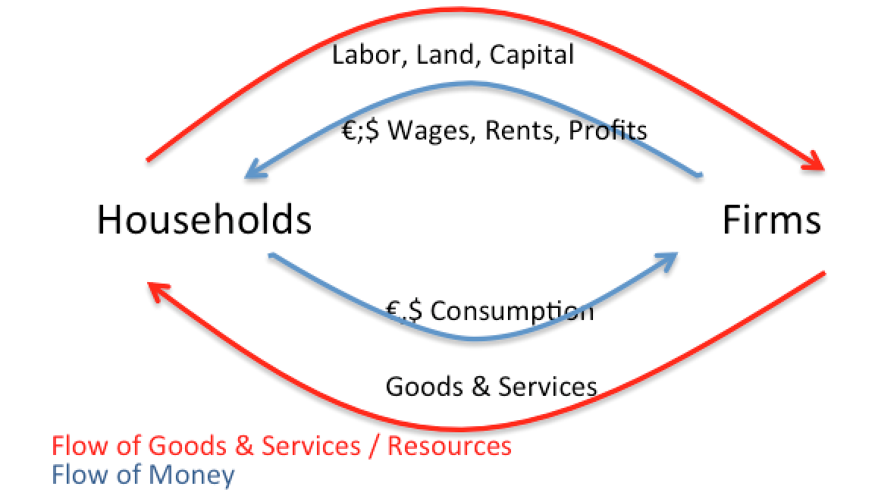
Circular Flow Model
Participants in the simple model:
Households
Firms
Firms supply goods and services to meet consumers’ needs
HH pay for those ($ or €)
HH provide e.g. labor to firms.
Firms pay wages in return.
The simple circular flow of a market economy can be expanded by:
Banks
States (= governments)
The rest of the world

Slide 5

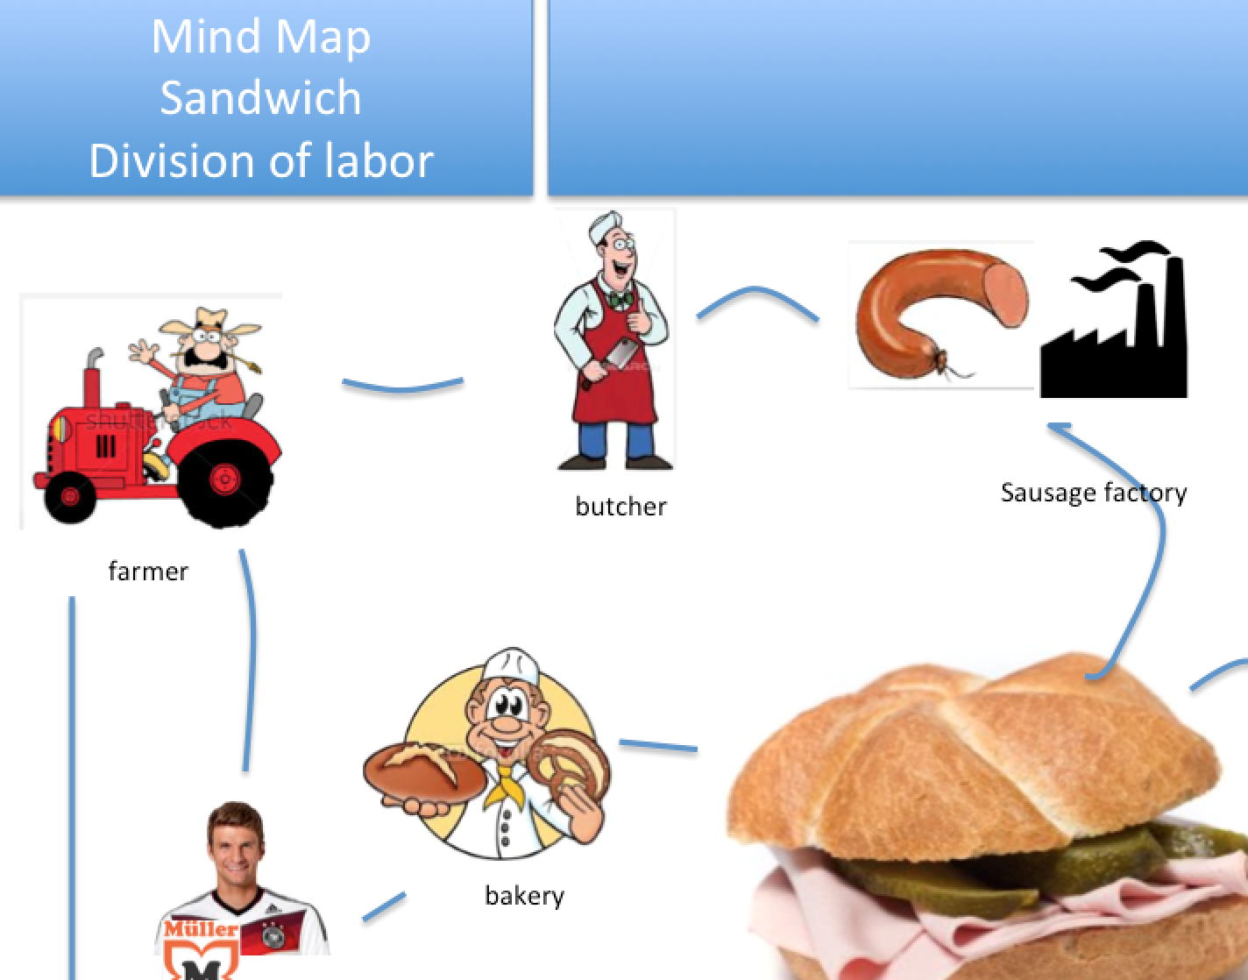
Division of labor
Types of division of labor:
1) Within an enterprise: different departments (marketing)
2) Regional division of labor: wine & fruit (Wachau valley)
3) International division of labor: globalization (China)
4) Economic sectors within one country:
Primary (agriculture)
Secondary (industry)
Tertiary (retail & services)
> Mindmap of the division of labor for a sandwich
We can trace a sandwich back from a supermarket, to the factory, to agriculture.
+ Advantages: higher productivity per worker
- Disadvantages: potential unemployment

Slide 6
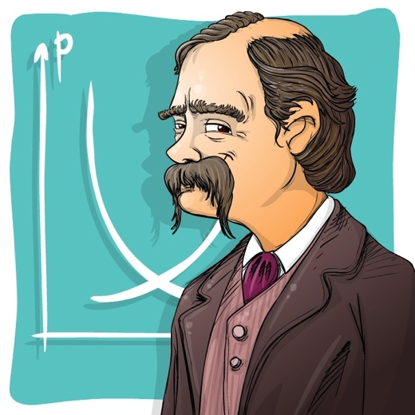
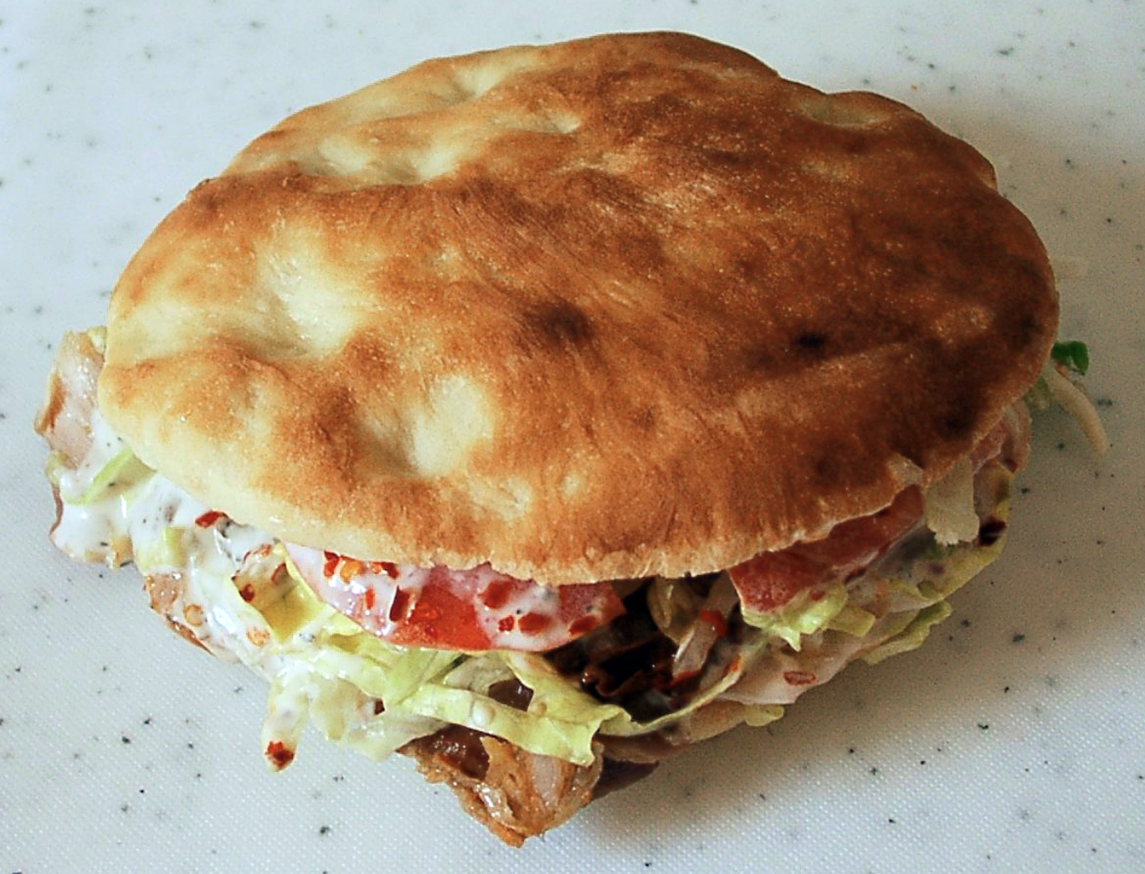
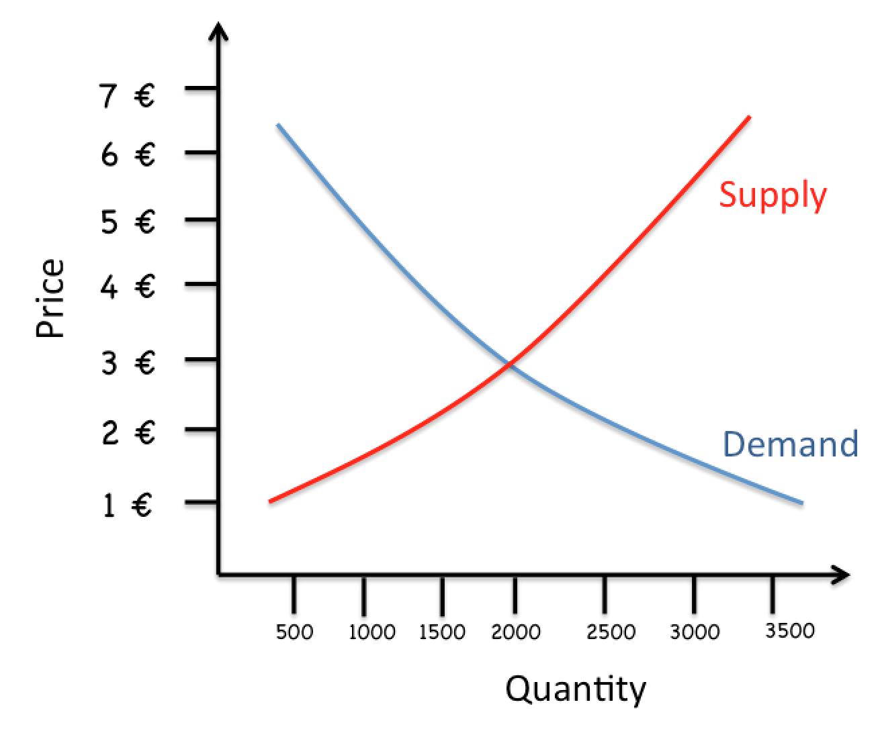
How does a market work?
Markets: fish market, car boot sale, financial market…
The market is where buyers and sellers meet and agree on prices.
Market model:
Function of prices and quantity
Demand Curve
The higher the price, the lower the demand
Supply Curve
The higher the price, the higher the supply
In Vienna, the market price for a kebab is currently €3.
At this price, approximately 2000 kebabs are sold.
At a price of €6, more than 3000 kebabs would be offered, but only 500 would be sold.

Slide 7
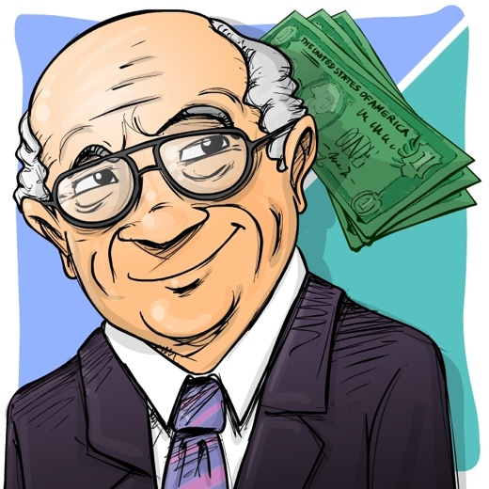

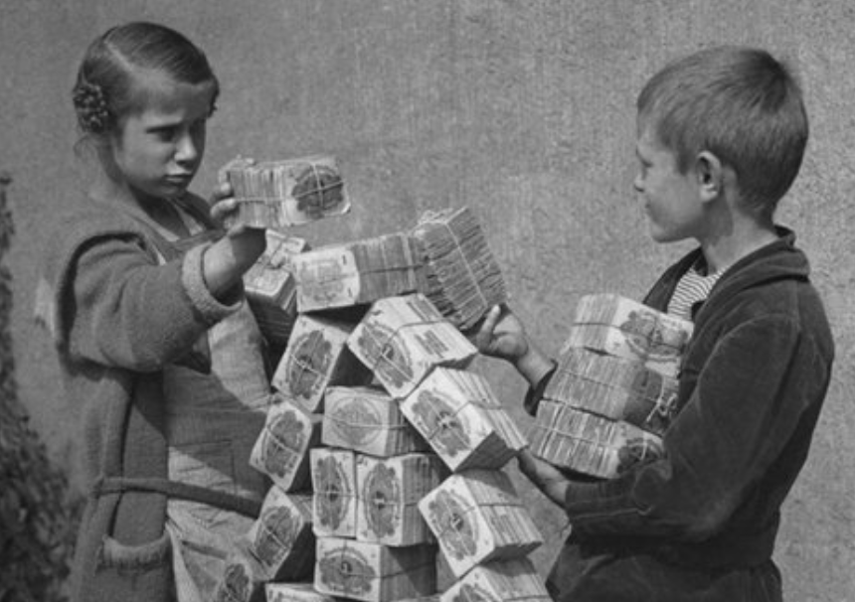
Money
Money, everything you can use for payments
Functions of money
Means of exchange (instead of barter/trade)
Preserves value
Calculation: 1€+2€=3€
Financing → you can ask your bank for a loan
The value of money can change!
Inflation & Deflation
Inflation: level of prices rises (money loses value)
Picture: Hyperinflation in Germany 1923
Deflation: level of prices decreases (money gains value)
Both inflation and deflation are a problem: The European Central Bank’ (ECB) target is a maximum of 2% inflation
2) Exchange rates (Sep. 2017): €1 = US$1.2
High rate of exchange (e.g. €1 = US$2) → good for Europeans traveling to the US and for imports
→ because you get more US$ per €
Low rate of exchange (e.g. €1 = US$1) → good for Americans traveling to Europe & exports
→ because Americans get more € per US$

Slide 8
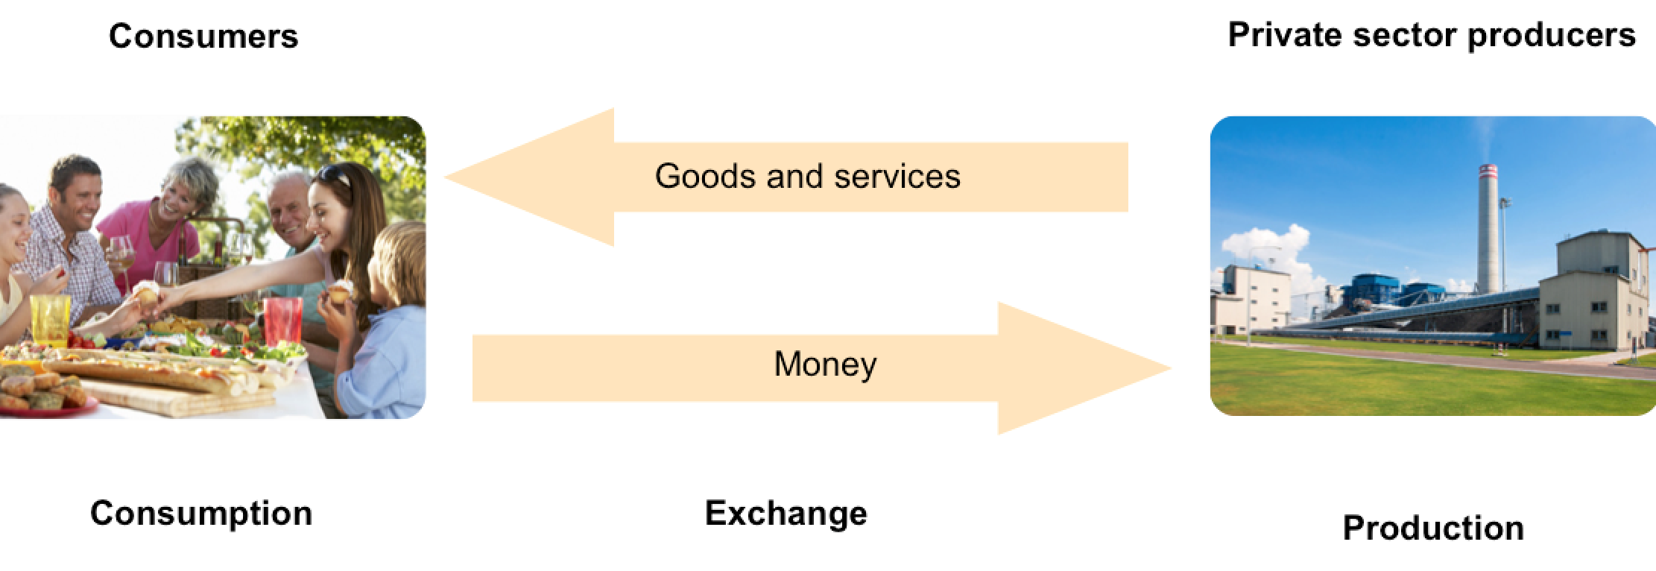
Free market economy
Free market economy:
e.g. UK, Hong Kong, US
Economist: Smith
In a free market economic system, all decisions are taken by private sector organizations and individuals.
There is little (provision of the legal frame) or no role for the government or a public sector and therefore little or no taxation or public spending.

Slide 9
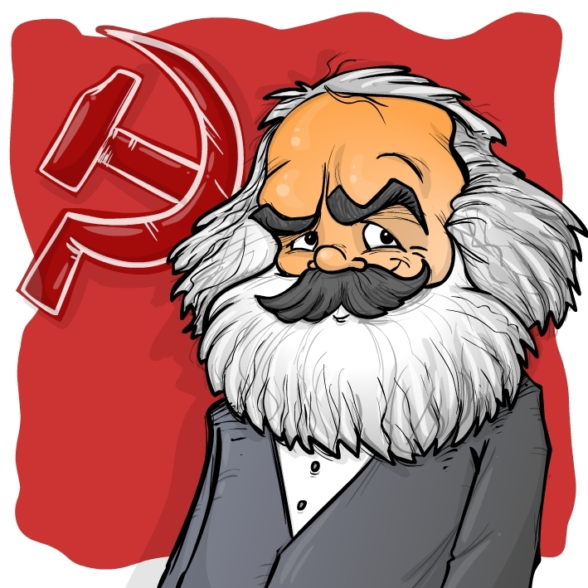
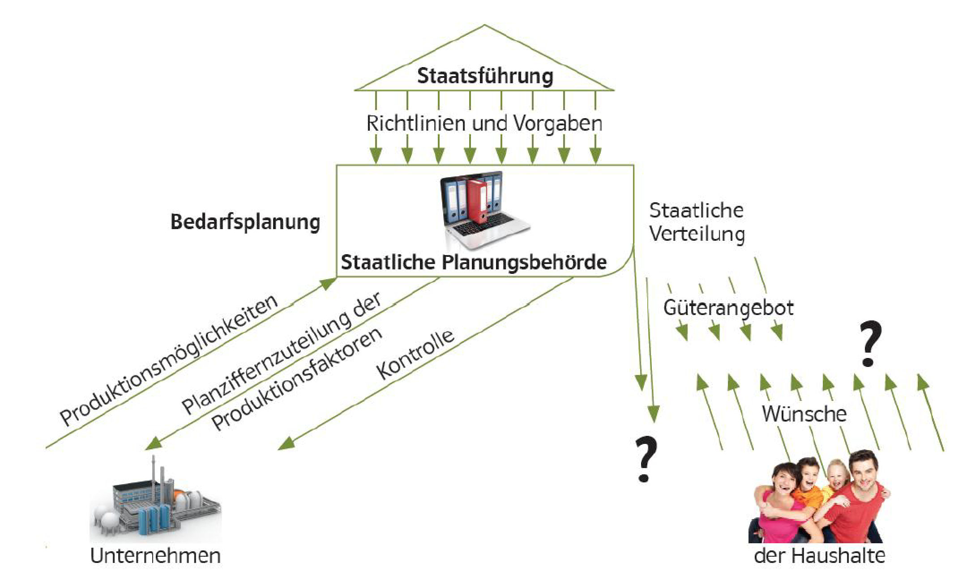
Planned economy
Government
Planned Economy:
e.g. North Korea,
earlier: Soviet Union, China, Cuba
Economist: Marx
In a planned economy all decisions are taken by the state.
Decisions on production and distribution of goods and services are done centrally by the state through a planning agency. There is no private equity.
Guidelines
Planning of needs
Provision of
goods
and services
Planning Agency
Production
Coordination
Control
Wishes
Firms
Households

Slide 10
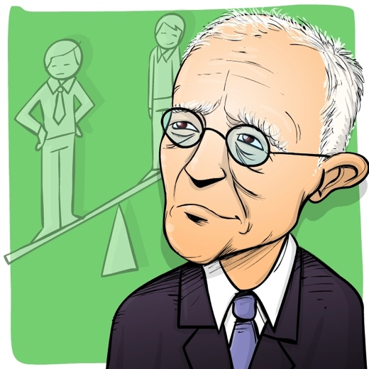
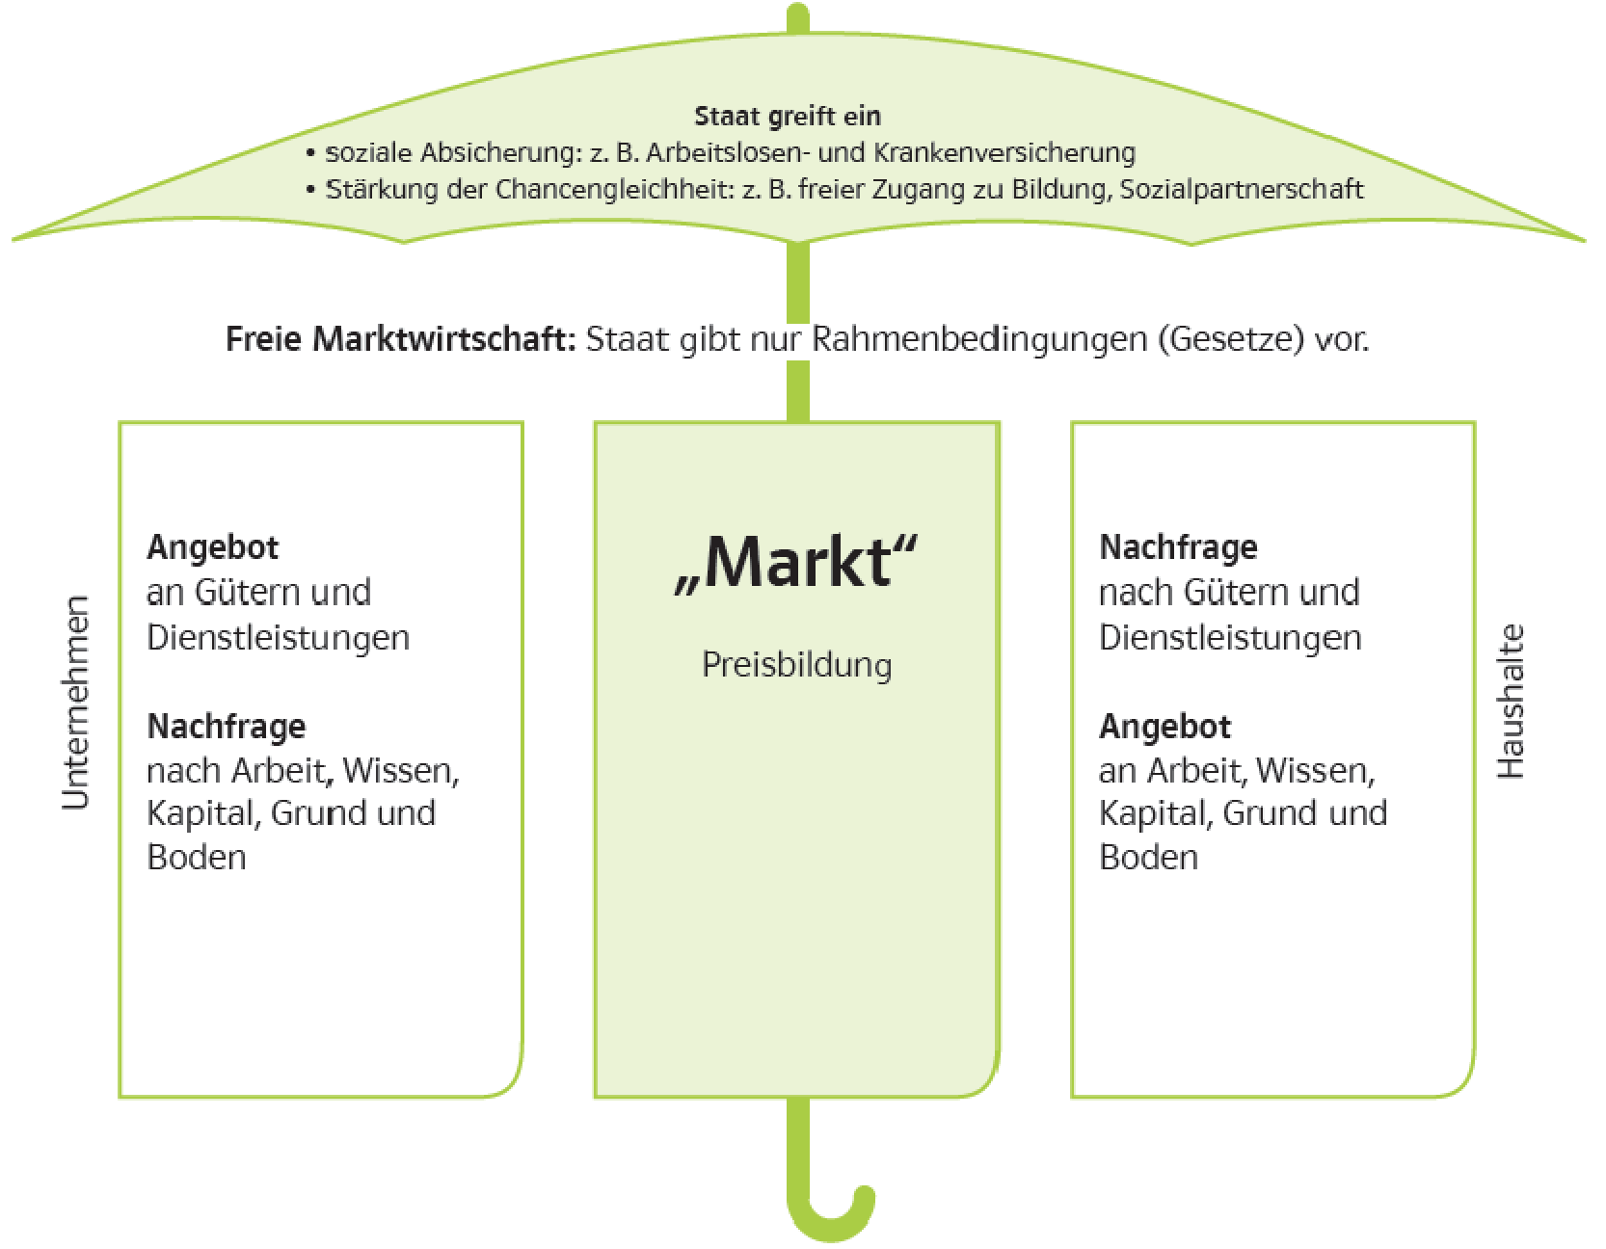
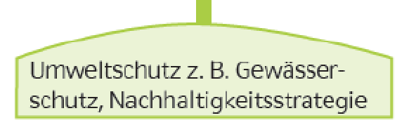
Mixed economies
(eco-social-market economy)
Mixed economy: Germany, Austria, EU
Economist: Eucken
In a mixed economy, a government can intervene in different markets in an attempt to correct the worst market failures:
It can provide useful and essential goods and services
It can provide goods and services for people in the greatest need
It can employ people in public sector organizations and provide financial support to private sector firms to boost output and employment
It can outlaw the production of harmful goods and dangerous activities
It can outlaw business practices that restrict competition or mislead consumers
It can introduce laws to protect the environment.
State intervention:
Health care, taxation and redistribution to people with greater need, education, infrastructure, etc.
Elements of a free market economy: provision of a legal frame
Protection of nature
Environment protection act
Sustainability, etc.

Slide 11
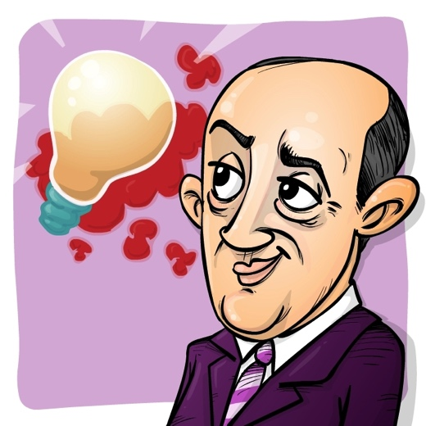
Business cycles
Business cycles:
ups and downs in the economy
GDP gross domestic product = total yearly income in an economy
Measurement: average GDP per head
= sum of all goods & services – resprecive inputs to avoid double counting
GDP= economic growth (+ income,
+ jobs, - environment)
 GDP = recession (- income, - jobs, + environment)
Weaknesses of focusing on GDP (ecological or social aspects are neglected)
→ Alternatives:
HDI – Human Development Index
Happy Planet Index, and others

Slide 12

Implementation of the eco-social-market economy
1) Implementation of the “social partnership”
important instrument of the Austrian social market economy
a system of institutionalized cooperation between labor, business and government that is involved in all important aspects of economic and social policy such as minimal wages, working hours, etc.
to avoid conflicts between the participants in the economic cycle
2) Laws which protect the environment
Social Partnership Austria
Employer
Employees/ Workers
Chamber of
commerce
Chamber of
agriculture
Chamber of
workers and employees
Trade unions

Slide 13
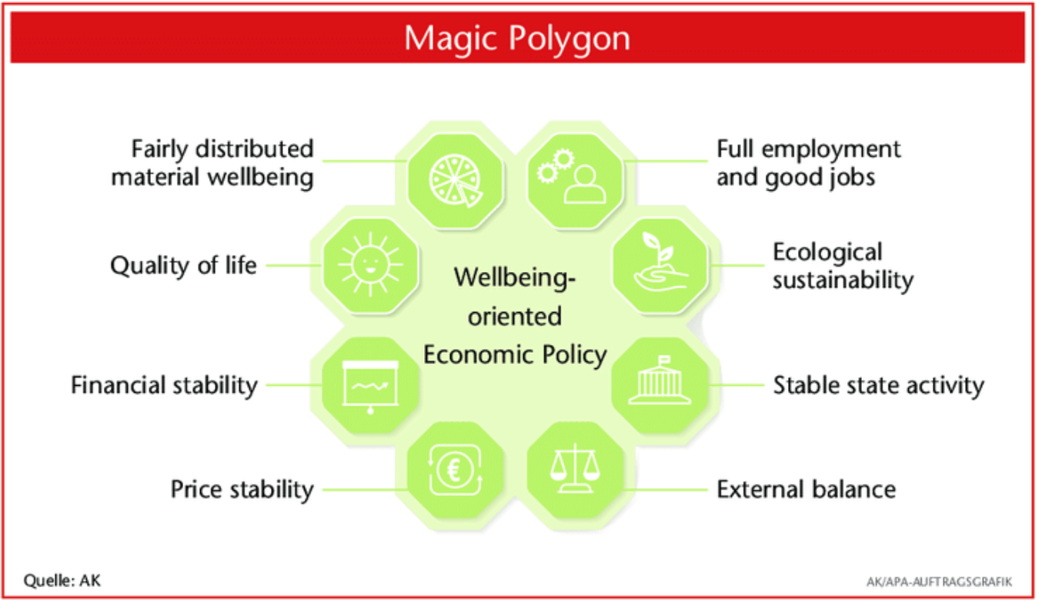
Goals of economic policy
Economic policy:
Sum of all planned measures of the state and other institutions (ECB, national banks, social partnership, EU) to stimulate the economy through:
Monetary policy (central bank: ECB)
Fiscal policy (taxes)
Labor market and social policy
Health and education policy
Environmental policy
Targets / Magic polygon:
> very difficult to realize several goals at the same time:
... very often you’ll find conflicting goals
e.g. growth and environmental protection
at the 3rd runway for the Vienna Schwechat airport

