Slide 1
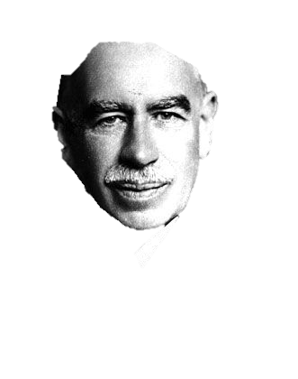
Keynes Beauty Contest
By Paula Stöckelle & Kirsten Viardo

Slide 2
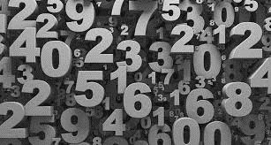
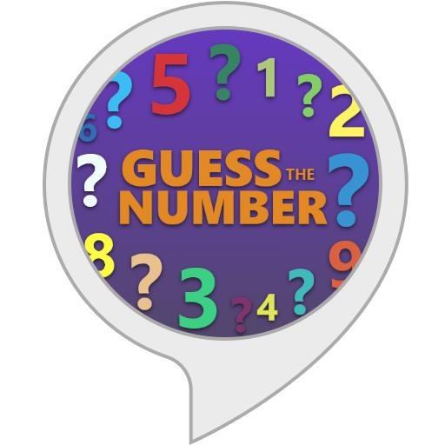
The game
Number between 0 & 100
Write onto White Board
Winner: closest to goal number
Goal number = 1/3 of the average

Slide 3
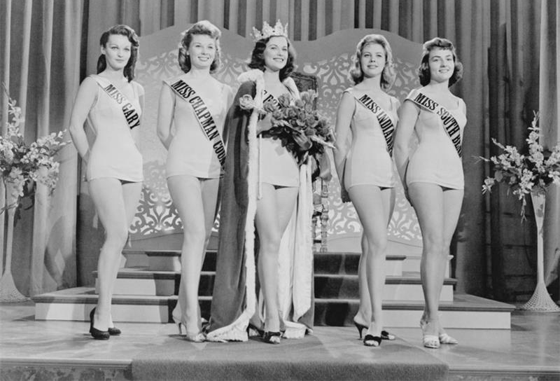
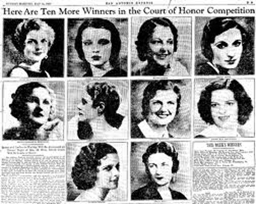
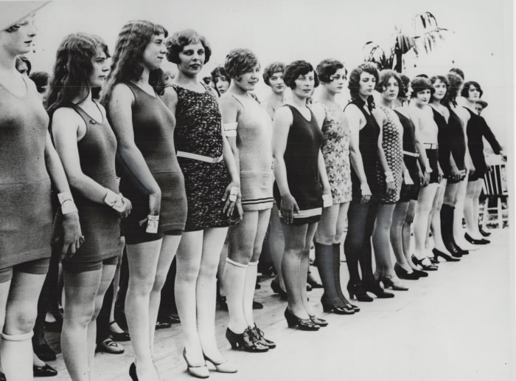
Keynes Beauty Contest
John Maynard Keynes
1936
The General Theory of Employment, Interest, and Money
100 Pictures
Not what we like
What we assume other people think others will pick

Slide 4
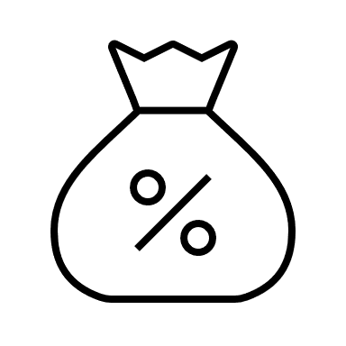
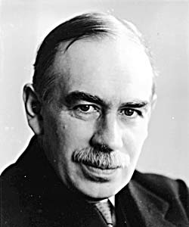
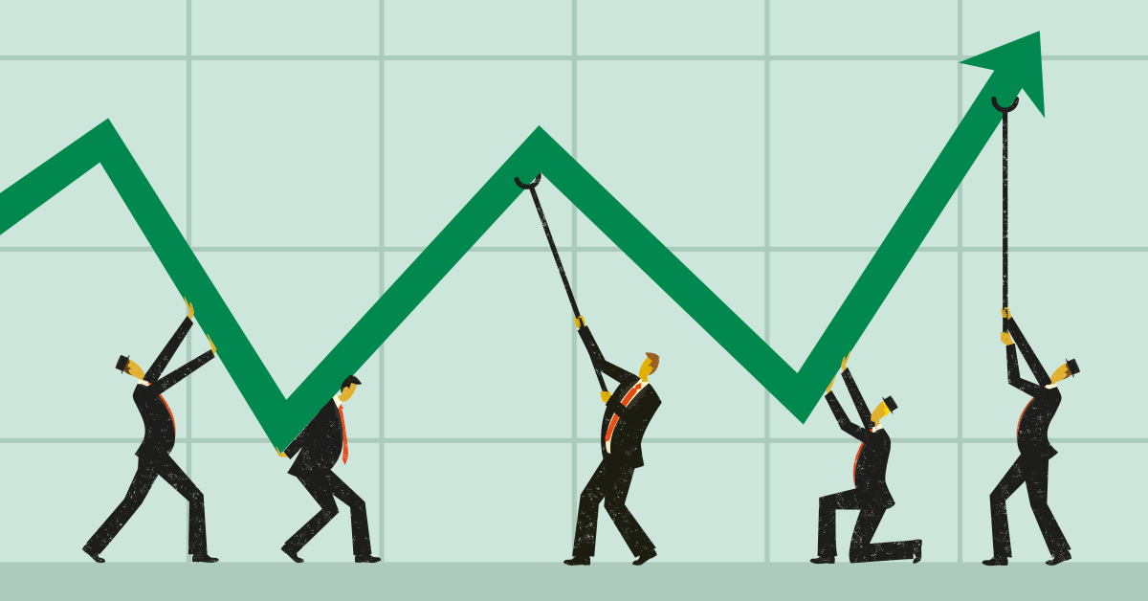
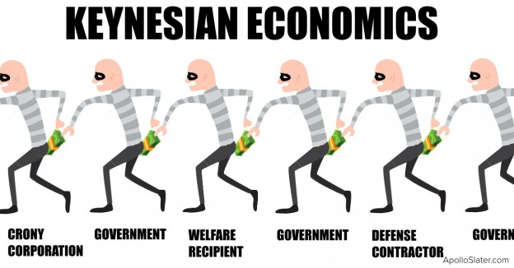
Keynesianism – Theory of Economics
State influences flow of economy
Straighten economic fluctuations
Full employment
→ ORGANIZE, HELP

Slide 5
Behavioral Economics (BE)
Economic decision-making
Rational Choice
Careful weighing of costs and benefits
Prospect Theory
Certain framing of choices

Slide 6
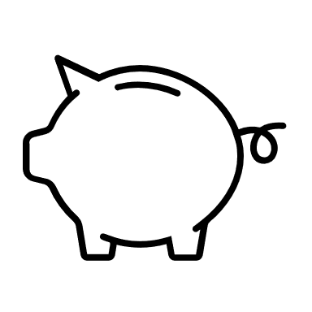
The Game
Number between 0 & 100
Write onto White Board
Winner: closest to goal number
Goal number = 1/3 of the average
Keynesinism – Theory of Economy
State influences flow of economy
Straighten economic fluctuations
Full employment
→ ORGANIZED, HELP
Keynes Beauty Contest
Keynes Beauty Contest – Original
John Maynard Keynes
1936
The General Theory of Employment, Interest, and Money
100 Pictures
Not what we like
What we assume other people think others will pick
Behavioral Economic (BE)
Economic decision-making
Rational Choice
Careful weighing of costs and benefits
Prospect Theory
Certain framing of choices

Slide 7
Question Time

