Slide 1
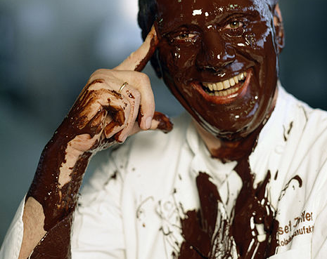
Fall and Rise of Josef Zotter
„Major business failures“
Bergheidengasse
2hrd 2020_21
Werner Holzheu

Slide 2
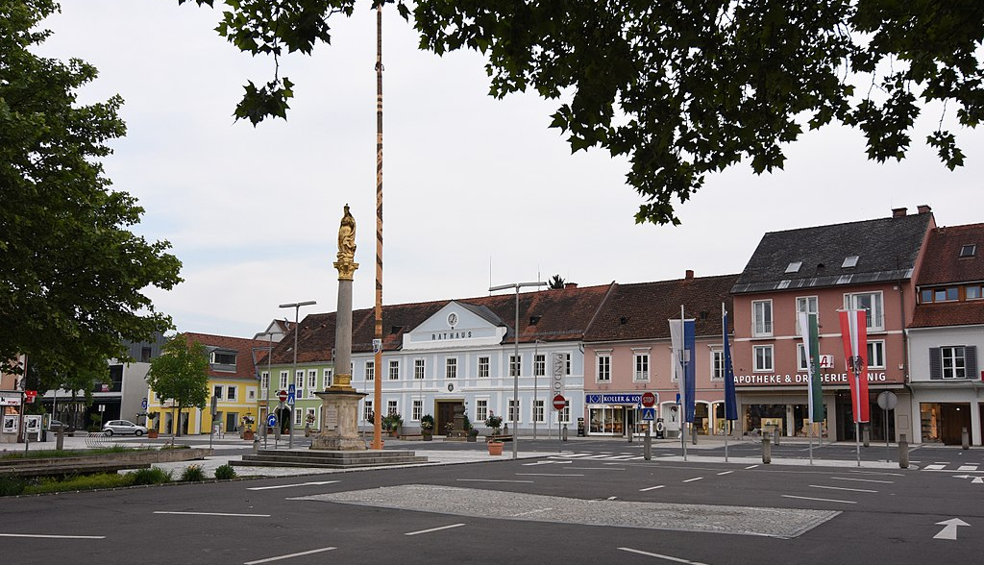
1961 born in Feldbach Styria / Austria
Was trained as chief in Söchau
As cook and partissier he moved to different places including the USA
Joined Werner Matt at the Vienna Hilton
And in 1987 we wanted to start his own business

Slide 3
In 1996:
Bankruptcy
Josef Zotter moved to Graz in 1987.
Founded his own business – a confisserie.
Opened up quickly 4 branches.
Being an entrepreneur is different from working for a hotel (management people, finance, …)
Liquidity crises in 1996
Bankruptcy and closure of business (Konkurs)

Slide 4
Back to success with creativity innovation right mindset
Returned to his parents’ farm at Bergl near Riegersburg
Focused on his routes
Used his creativity to try something new: He reinvented chocolate!
Hand scooped chocolate in many different flavours
His creations became a ”must have”.
By 2008
> 14 Mio € revenue and
> 3 Mio € profit

Slide 5
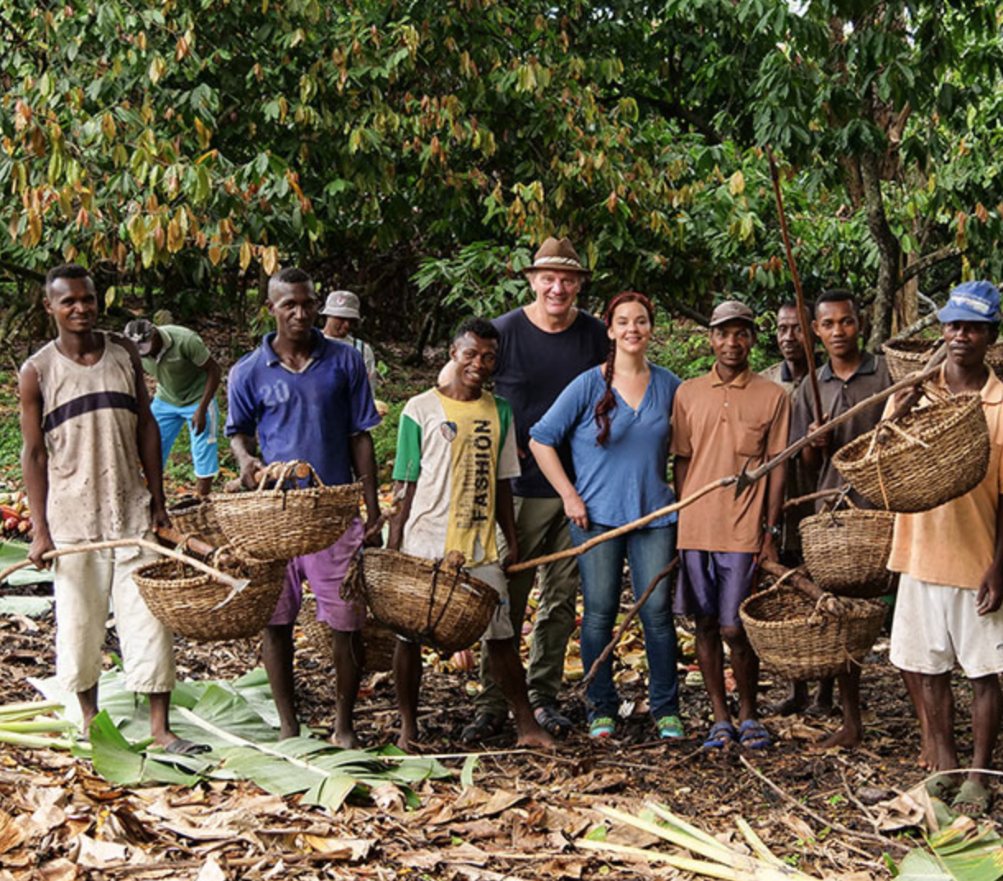
Bean to bar philosophy 100 % organic 100 % fair trade

Slide 6
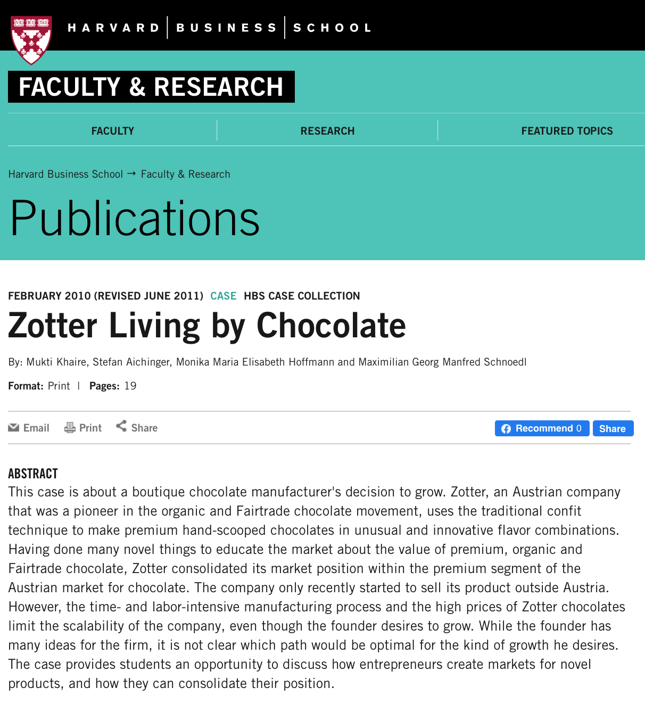
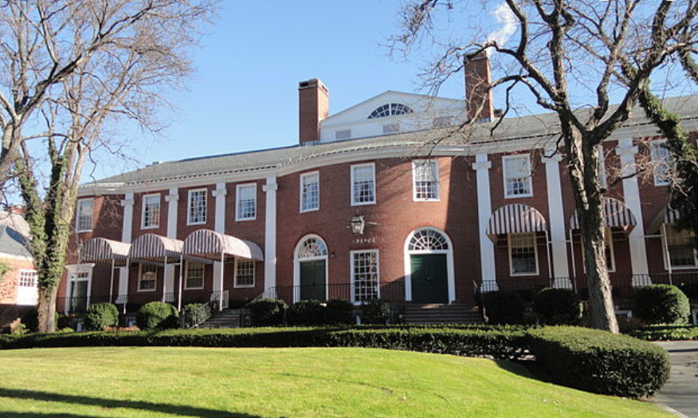
2010 Invitation to Harvard Business School

Slide 7
One of Austria’s most innovative and successful entrepreneurs
> 500 different flavors (vinegar, bread or fish?)
> 500 tons of cocoa beans per year
> 80.000 chocolate bars per day
> 200 Employees
Member of World Fair trade organisation
Since 2015 among Top 25 chocolatiers in the world
Academy of Chocolate Award 2016 / London
Best Employer Award in Styria Award 2020
https://www.youtube.com/watch?v=KOpJtz8_v3U

