Slide 1
Market Structures
Amelie Rieß | Leya Lenz | Economics

Slide 2
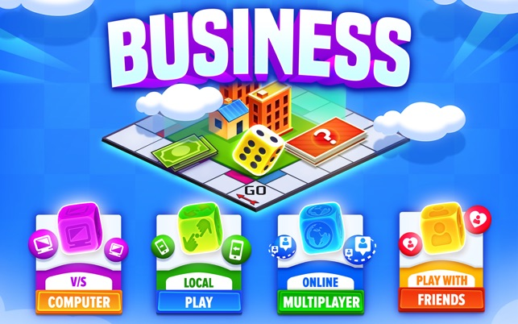
Business Game: Monopolist
Download im App Store / PlayStore
Play With Friends -> Create Room -> andere treten mit CODE bei
4 x 4 Gruppen & 1 x 6er Gruppe
Spielzeit: 30 Minuten

Slide 3
What is a market?
Latin "mercatus"
Process of establishing the prices of goods and services
Place where potential buyers & sellers meet
Different types of markets

Slide 4
Pricing
Determined by cost, the market & competition
Supply and demand
Goals: low expenses & highest possible income
7 pricing models

Slide 5
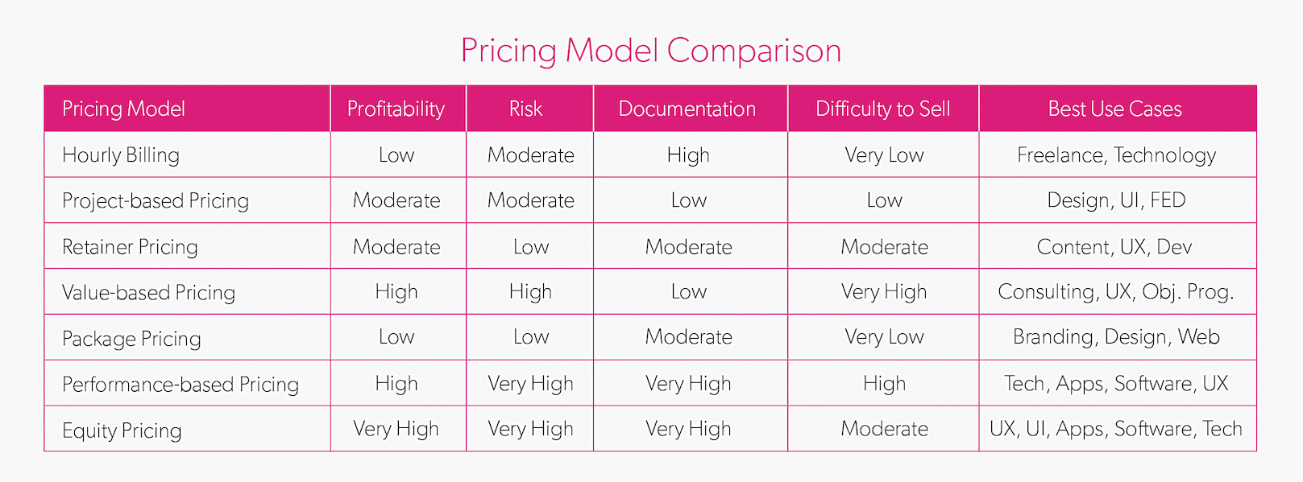

Slide 6
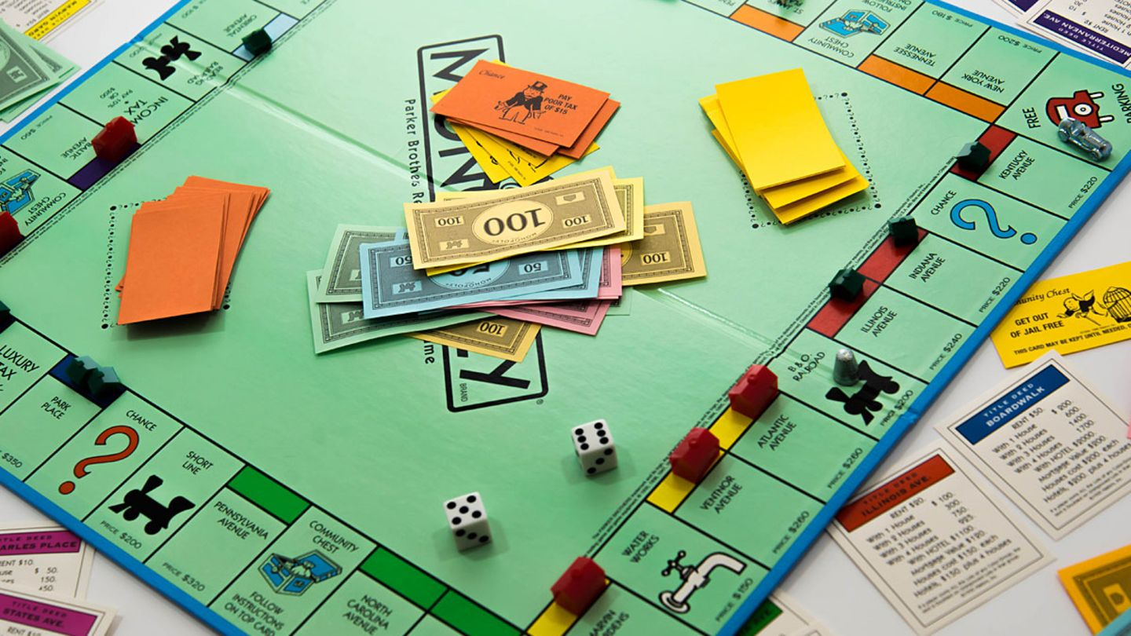
The market structures
Describes the structure of supply & demand
3 main structures
Polypoly (many suppliers)
Oligopoly (few suppliers)
Monopoly (only supplier)
examples

Slide 7
Perfect Competition / Polypoly
Monopolistic Competition
Oligopoly
Monopoly
The market structures
Most competetive
Least competitive

Slide 8
Discussion
Money-Management
Similarities Monopoly/Bankrupt vs. Real-Life Economics
Learning effects of the game

Slide 9
Thank you for your attention!!
Leya Lenz | Amelie Rieß

